Slide 1
Safety and Security
Office of International Programs

Slide 2
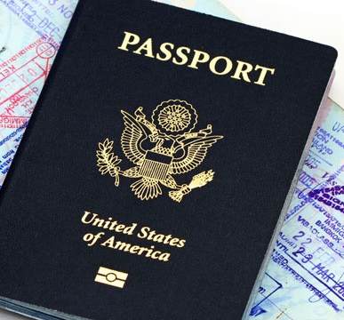
Checklist:
All signature documents signed on Terra Dotta
Copy of Passport on Terra Dotta
No Financial Holds
On Call International / Health Insurance
On Call International card
Notes:
-Hand out On Call Document/Card

Slide 3
Safety:
Visit travel.state.gov to read more information about safety and security in your host country.
‘Learn about your destination’

Slide 5
Embassies and Consulates
Visit travel.state.gov
US Embassy Prague
Phone Number: +(420) 257-022-000
Emergency After-Hours: +(420) 257-022-000
Address: Tržiště 15 118 01 Praha 1 - Malá Strana Czech Republic

Slide 6
Embassies and Consulates
Visit travel.state.gov
US Embassy Vienna
Phone Number: +(43)(1)-31-33-90
Emergency After-Hours: +(43)(1) 31-339
Address: Boltzmanngasse 16 1090 Vienna, Austria

Slide 7
Safety:
Enroll in the Smart Traveler Enrollment Program in order to receive the most up-to-date security information.
Visit step.state.gov to enroll.

Slide 9
Safety:
Alcohol; Alone; At Night.
Follow the directions of your program leaders at all times.
Be conscious of your surroundings.
Keep the On Call International card on your person.
On Call International should be your first point of contact in the event of an emergency.

Slide 10
On Call International
Mercer University has partnered with On Call International to ensure that you have access to immediate high quality support in the event of an emergency when you are away from home.
On Call International provides worldwide quality medical, travel and security assistance services 24 hours a day.
On Call will coordinate benefits with medical insurance policies that you hold whenever possible or with authorization from Mercer. On Call will facilitate a guarantee of payment to your medical provider. Any medical expenses that are not reimbursable from your medical insurance carrier may ultimately become your responsibility even if they are paid for at the time of the case.

Slide 11
Title IX Sexual Misconduct and Relationship Violence
Mercer defines Sexual Misconduct and Relationship Violence as:
Sexual harassment
Sexual assault (rape)
Non-consensual sexual intercourse
Non-consensual sexual contact
Sexual Exploitation
Stalking
Interpersonal Violence
Dating and Domestic Violence
Mercer’s policy applies to all employees, students, campus visitors or third parties, regardless of sexual orientation, gender identity or location – this includes Mercer on Mission and Study Abroad programs.
See Sexual Misconduct and Relationship Violence policy for complete definitions.

Slide 12
Resources and Reporting
If you or someone you know experiences sexual misconduct or relationship violence while abroad, please contact your program leader as soon as possible.
Your program leader will assist in calling On Call International and the Office of International Programs.
In the event of a Title IX issue, I will contact Melissa Nunn, Mercer’s Title IX Coordinator.
The Title IX Coordinator will work with the appropriate personnel to implement a plan of action.

Slide 13
Title IX Coordinator Contact Information
Melissa M. Nunn, M.S.
Title IX Coordinator, Mercer University
478.301.2788
Nunn_M@mercer.edu
or
TitleIX@mercer.edu

Slide 14
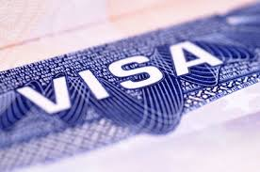
Visa | Passport
US Citizens:
Make sure that your passport is valid for more than 30 days after your intended departure.
Make sure that your passport has two blank visa pages for the entry stamp.
Non-US Citizens:
Be advised that you will need to research Visa requirements and complete the process prior to your departure.

Slide 15
Student Conduct:
Abide by the laws of your host countries and the United States.
Abide by Mercer University’s student conduct policies.

Slide 16
General:
Banking: call your bank to let them know that you will be traveling abroad.
Banking: expect a 3% international conversion fee and a $5 ATM bank fee.
General: keep a copy of your passport in luggage and provide a copy to your program leaders.

