Slide 1
by Victoria Iyere Joey Heath Theo Stathakis Sebastian Prokop
BAA 607
Jordan M. Blanke, Ph.D.
July 7, 2014

Slide 2
Walmart in E-Commerce
Walmart’s goal is for every person and every product to be connected
Social Media with Kosmix
Walmart’s search engine Polaris
Scan & Go self checkout smartphone application

Slide 3
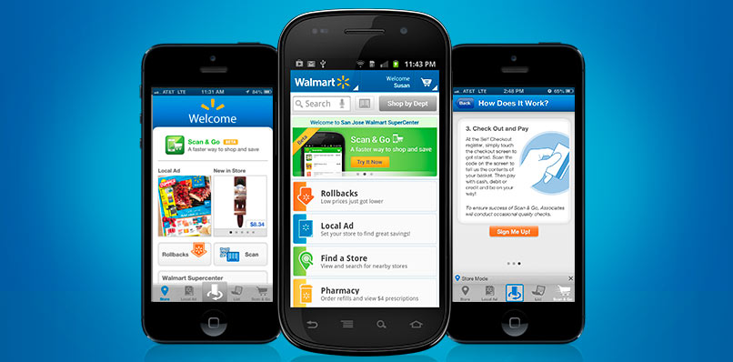

Slide 4
Walmart’s Privacy Policy
Walmart can share information with third parties
Can track customers through cookies
Use date created with gift registries, applications for hunting and fishing licenses
Automatically collect information from mobile devices; Unique Device Identifiers (UDID)

Slide 5
Walmart’s Privacy Policy
Walmart’s customers have no right to have their information deleted
Even if customer deletes the Walmart application the information still remains on the device
When children access the Walmart site there is no guarantee for the information to be deleted

Slide 6
Technical Reasons for Data Collection
Most of the collected data is required to target advertising and product suggestion for users
Information about a device, location and pages are needed for the app or site to function properly
Additionally, information about the device the pages and screens are useful for developers to identify the aspects to improve in the future

Slide 7
The Amazon Threat
Amazon had already marginalized once big players like Barnes & Noble and Best Buy
Attack on Walmart was clear when Amazon started to sell staples such as soap, diapers, pet food, and bulk tissue products
Even offered customers option to subscribe to receive these items regularly
Walmart not much of a threat to their e-commerce
Notes:
Questions: How many people, who actually shop at WalMart, go in for 1 thing and come out with much more then intended?
With the subscription, it could pull sales away from WalMart, because with Walmart being the largest grocer, they relied on the fact that people would go to Walmart for their regular items and groceries like the soap and diapers, and always end up buying other things while they are there as well.

Slide 8
Walmart’s Failure
The 27 worldwide subsidiaries did not use compatible tech
The websites were not connected with the stores or the supply chain
Walmart.com search engine epitomized the failure
Walmart Labs exec said “This is embarrassing.”
Notes:
If a user searched for smartphones they would get links to cell phone chargers, but not even to an iPhone
A search for Cotton Sock would return Cotton Candy and balls of yarn

Slide 9
From Big-Box to E-Commerce
Bought startup Kosmix to revamp online strategy
Their expertise is in search and analytics
Algorithms understood what user wanted vs. just matching search text
Essentially artificial intelligence
First project was to create a new search engine
"You can connect the social experience, the in-store experience, and the online experience. Nobody could do that.” -Rajaraman, Co-Founder
Notes:
They attempted to simplify the masses of the internet and determine what you are actually looking for.
Would even be able to find pages that didn’t even contain the search terms but was related to the topic the searcher was interested in/looking for.
Example: if you’re looking for fire alarms, you would also get evacuation plans and safety tips in your search results, that may not even have ‘fire alarm’ as a key phrase
The 2 founders(Venky Harinarayan and Anand Rajaraman) left Amazon and saw opportunity in walmart they didn’t see there (quote)
People are always offering clues about products on social media--writing reviews, liking brands, checking into stores, announcing the products they want to buy, and the Kosmix program could tie all that together with searches
The new search tools increased conversion rate of visitors to buyers by as much as 15%

Slide 10
First Steps
Owners turned Kosmix into Walmart Labs
Rolled out with new projects
Shopycat
Get on the Shelf
Goodies Subscription
Social Media prediction
“Walmart people” often say the only way they will win online is by ‘being Walmart’
Notes:
Shopycat: Gift recommendation app on Facebook. Launched in 2011 before the holidays. Shopycat scans your friends' profiles to identify interesting gift ideas from their stream of likes, comments, and status updates, discerning if the "Ted" your pal is raving about is the geeky ideas festival or the Seth MacFarlane stoner comedy. Shopycat then seeks out an appropriate gift for such a stoner/thinker from Walmart's product database. Walmart says Shopycat led to an increase in purchases on the site, though it won't say by how much. For the 2012 holidays, the team built Shopycat into a section of Walmart.com called Walmart Gifts; customers will log in with their Facebook or Twitter account to get personalized recommendations.
Get on the Shelf: a project to get customers to think differently about walmart and e-commerce. It was an online contest for people to submit their own inventions to go on sale at Walmart. It was a social marketing blockbuster, garnering more than 4,000 submissions, over 1 million votes, and news hits in small towns across America.
Goodies: customers pay seven dollars a month for home delivery of a gourmet food box--creating a discerning test market for the grocer in the process.
Social Media Prediction: The technology uses spikes in social network chatter to predict demand for uncommon products. One year they anticipated heightened customer interest in cake-pop makers based conversations on Facebook and Twitter. There was once a growing interest in electric juicers, tied to the popularity of the juice-crazy documentary Fat, Sick and Nearly Dead. As these signals become stronger, execs say it will play a larger role in purchasing decisions.
Walmart doesn't need to be something radically different. The company that mastered IT in the service of unbeatable prices must now master web technology. It doesn't need to chase Amazon so much as it needs to identify how a digital Walmart can be as much a part of its customers' lives as the stores are today.

Slide 11
Walmart.com Marketplace
Launched Pangea program to redevelop technology platform
Common technology to run the 10 e-commerce sites worldwide including Sam’s Club and Asda (U.K.)
Walmart only own about 300,000 – 400,000 items on their site though they offer more then 2 million
6 participants in marketplace that offer the other items on Walmart.com
Notes:
Wayfair
Plumstruck (part of Hayneedle.com)
eBags Inc.
ProTeam (part of Dreams Inc)
Tool King
Shoebuy.com

Slide 12
Omni-Channel Commerce
Strategy brick and mortar companies are trying to implement to stay relevant and compete with Amazon
Same day delivery
96 percent of Americans live within 20 miles of a Walmart
Ship From Store option – goods delivered in 90 min time-frame
Store have their own fleets and mini warehouse management systems in back of stores

Slide 13
From the website:
@WalmartLabs is an accelerator in the effort to meet the needs of our customers where ever they are — shopping in a store, browsing our web site, or out and about with their mobile devices.
And they’ve been buying up different tech companies the last couple of years.

Slide 14
Inkiru
Active learning system that combines real-time predictive intelligence, big data analytics, and a customizable decision engine to inform and streamline business decisions.

Slide 15
Torbit
Website acceleration and optimization company that tracks correlation between website speeds and sales.
OneOps
Cloud computing startup that accelerates Walmart’s PaaS and IaaS strategies.

Slide 16
Adchemy
Specializes in “semantic search”
Trying to develop implied search results that go beyond the key words that are used.
Yumprint
Recipe discovery and shopping list creator
Allows users to “pin” recipes and will create shopping lists based on the recipes.

Slide 17
Tasty Labs
Software applications business that connects people via social software.
Social Calendar App
Facebook app for event reminders that would allow customers to shop on walmart.com directly from event reminders. No longer working.

Slide 18
Small Society
Create, develop and launch iOS applications
Grabble
Developed eReceipts solution that gives in-store shoppers instant access to a digital, picture-perfect version of their receipts.

Slide 19
Walmart RFID Technology
Radio Frequency Identification
Uses wireless radio-frequency electromagnetic fields to transfer data
Used for tracking objects from manufacturing to final sale

Slide 20
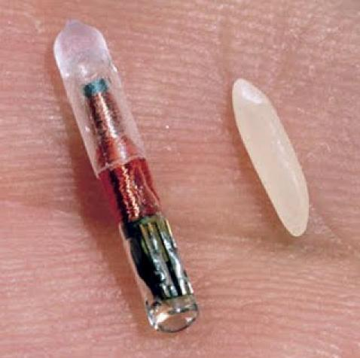
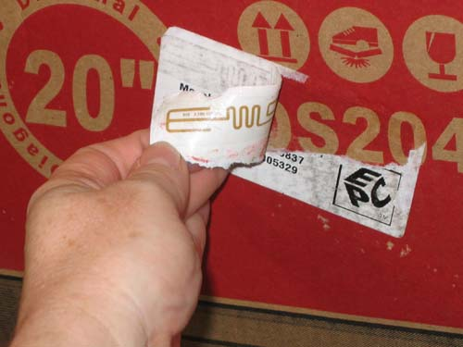
RFID Tags

Slide 21
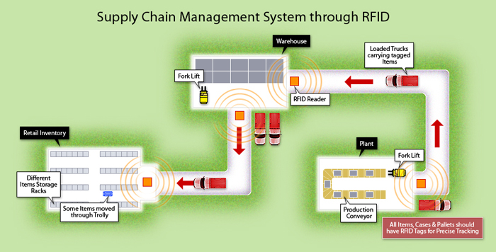
How RFID Works

Slide 22
How RFID Works
RFID Solutions
https://www.youtube.com/watch?v=RO2HR4Lip6Q

Slide 23
RFID Data
Stores unique information to each product
Serial numbers
Sizes
Quantities
Shelf life
Location tracking

Slide 24
Advantages to RFID
Lowers costs
Less manpower needed for inventory
Real-time inventory tracking
Reduced “stock out” for Walmart by 30%
Low energy use
BAP (Battery-Assisted Passive) vs. regular passive

