Slide 1
A CASE STUDY BY:
Lei Shi
Raj Patel
Ryan Bouc &
Frank Lawrence

Slide 2
What is “Pandora”?
Pandora Internet Radio (also known as Pandora Radio or simply Pandora) is a music streaming and automated music recommendation service that serves as "custodian" of the Music Genome Project.

Slide 3
What is “Pandora”?
The service, operated by Pandora Media, Inc., is only available in the United States, Australia and New Zealand.
The service plays musical selections of a certain genre based on the user's artist selection. The user then provides positive or negative feedback for songs chosen by the service, which are taken into account when Pandora selects future songs.

Slide 4
What Pandora Can Do?
allowing users to remove a song from the station temporarily, although it counts as a skip
allowing users to learn more about the composition of each song
Move song to another station; New Station; and Bookmark.
Buy button is located at the top of each song block as well. From there, listeners can click on links to buy the song from iTunes or Amazon.

Slide 5
The History of Pandora
2000 Pandora Founder Tim Wintergreen started the popular personalized radio service with the Music Genome Project
2004 the company returned to its initial vision of producing customized radio stations and changed its name to Pandora Media.
2011The company took a great many rounds of private investment from both Angel Investors and institutional Venture Capitalists before finally going public through and IPO
2013 Pandora announced that their radio streaming service had passed 200 million users, about 70 million of whom are active monthly

Slide 6
Mobile Devices
Pandora is available on the Google Android OS . It is ad supported and retains the original skip limits.
Pandora is available on the iPhone, but authorized downloads and installs are only possible with a US, Australian, or New Zealand iTunes account
the Pandora for BlackBerry application is limited to AT&T, Sprint, Verizon, T-Mobile, Boost Mobile, and U.S. Cellular carriers

Slide 7
SWOT
S:
Anytime/anywhere access
Personalized Radio Playlists & Recommendations
Brand Recognition
Free with option to upgrade
W:
Marketing
Advertisements for unpaid members
Personal music storage
Artist royalties

Slide 8
SWOT
O:
Integration into automobiles
Expanding Industry
T:
Spotify
SiriusXM Radio
Apple iTunes Radio

Slide 9
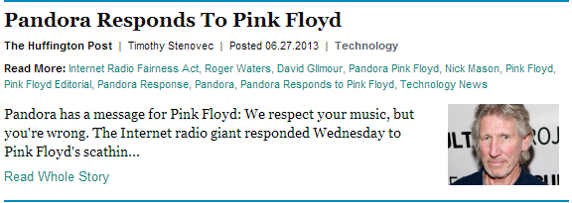
Internet Radio Fairness Act of 2012
> 50% in royalty fees vs. 7.5%
Allows webcasters to make digital copies of purchased music if solely used for webcasting
Global music rights database
Notes:
Pandora may decide to negotiate direct deals with labels, similar to Apple iTunes. Instead of fighting to lower royalties.

Slide 10
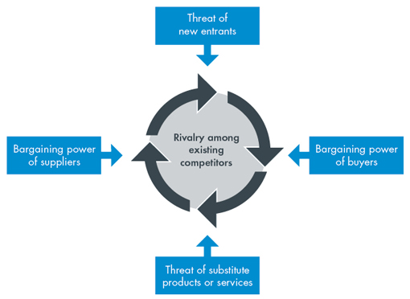
Porter's 5 Forces Analysis

Slide 11
Threat of New Entrants
* * * H I G H * * *
Easy to Enter the Market
Does Not Require Much Capital
Low inventory/Overhead
Constant Tech Innovation
Unpredictable Trends

Slide 12
Bargaining Power of Supplier
* * * M E D I U M / L O W * * *
Musicians Want to Be Heard
Access to All the Major Recording Labels
Performing Rights
Organizations Dictate Terms
Artists and organizations Face low Switching Costs

Slide 13
Bargaining Power of the Buyer
* * * H I G H * * *
Buyers Have More Choices
Brand Image
Mobility
Advertisers face low switching costs
End users face low switching cost

Slide 14
Threat of Substitutes
* * * H I G H * * *
Many Alternative Products
Low Barrier to Entry
Various Outlets of Substitutes

Slide 15
Rivalry
* * * M E D I U M * * *
First Mover Advantage
Low Barrier to Entry
Various Outlets of Substitutes
Many Alternatives Exist
Some Competitors are Major Media Corporations

Slide 16
Recap of Porter's 5 Forces For Pandora
Would You Invest in
Pandora?
= HIGH
MEDIUM/LOW=
= HIGH
MEDIUM =
= HIGH

Slide 17
Pandora to Date
Pandora’s Value to the Music Industry to Date
Pandora’s IPO
2.6billion Valuation
$16/share

Slide 18
Pandora Income Statement Review
Activities Introduced by Year, by Income Statement
2011 Income Statement
2012 Income Statement
2013 Income Statement
http://balance-sheets.findthebest.com/l/5892/Pandora-Media
http://finance.yahoo.com/echarts?s=p+interactive#symbol+p;range=5y

Slide 19
Current and Future Stock in Pandora
Current Value of the Company
Current Stock Value of the Company
Future Value of the Company

Slide 20
Back to the Future
Future Directions of the Company
Strategic Partnerships
Music Industry Opportunities
Independent Label Partnerships
Music Fan Involvement – Voting

Slide 21
Conclusion

