Slide 1
Application Technology
Erica Fields
Johnny Washington
Lorenzo Jackson
Lyndsei Pacini

Slide 2
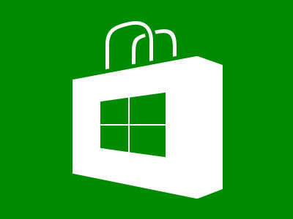
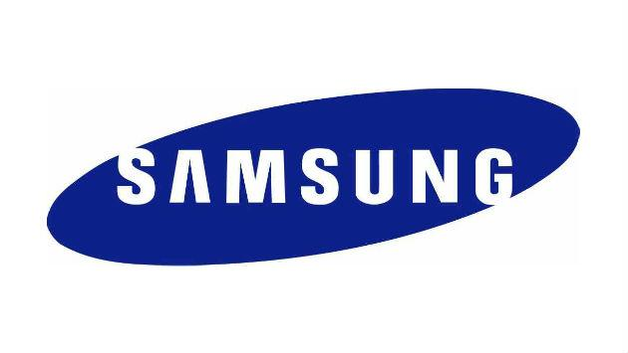
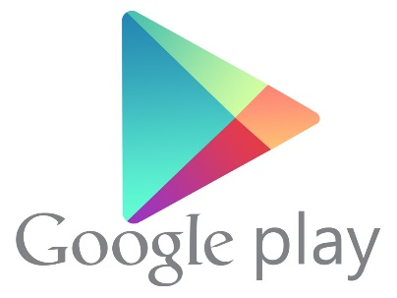
Introduction
History of Mobility
An App Based Perspective

Slide 3
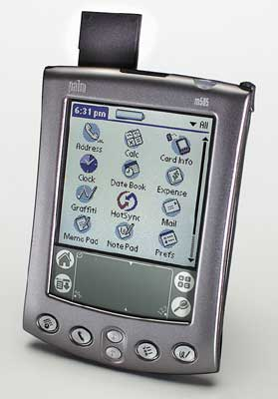
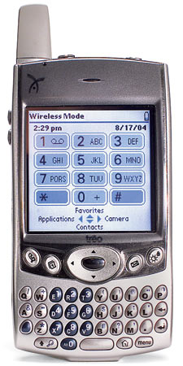
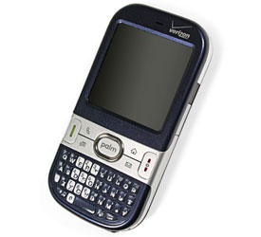
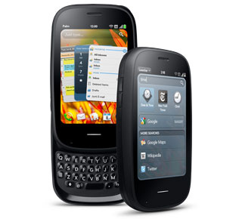
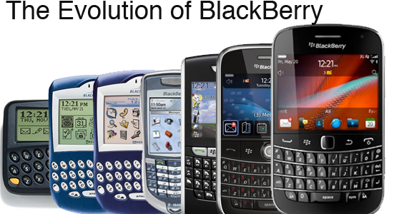
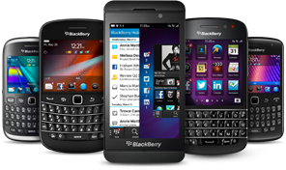
Palm Pilot, PDAs, Blackberry
The Evolution of Palm

Slide 4
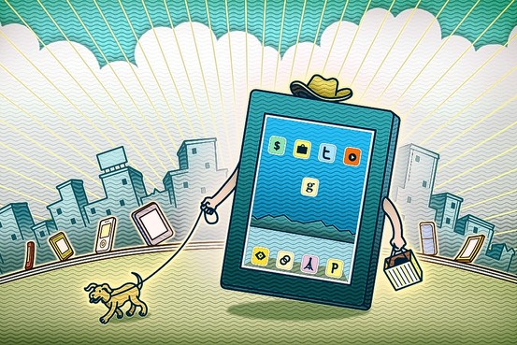
“The Rise of Apps, iPad and Android”
By Andrew Dowell
The Wall Street Journal (2010)
Peter Hoey

Slide 5
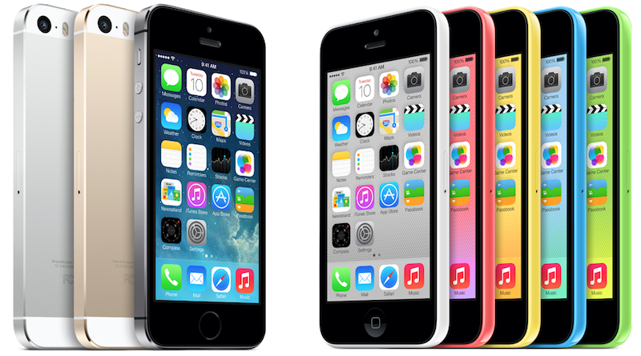
iPhone

Slide 6
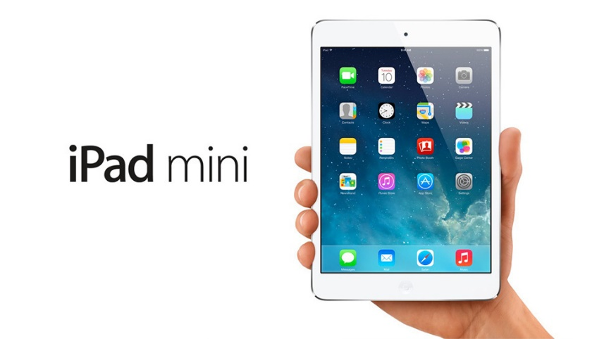
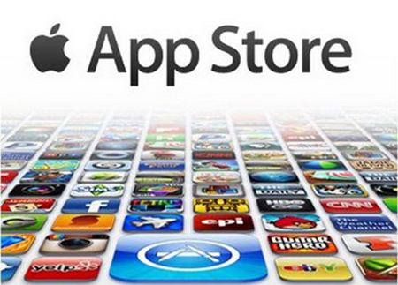
iPad
2010 – Apple created iPad
Successful unlike table-like devices introduced in the past
Tablet touch screen computing device
Sleek high resolution display
Content via iTunes and AppStore

Slide 7
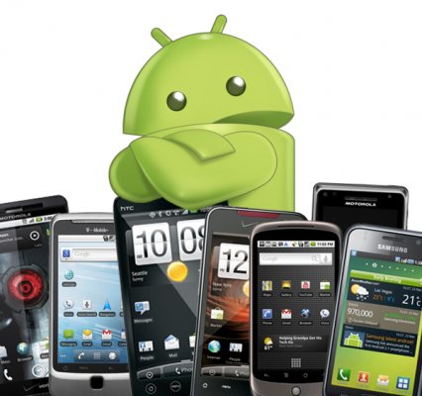
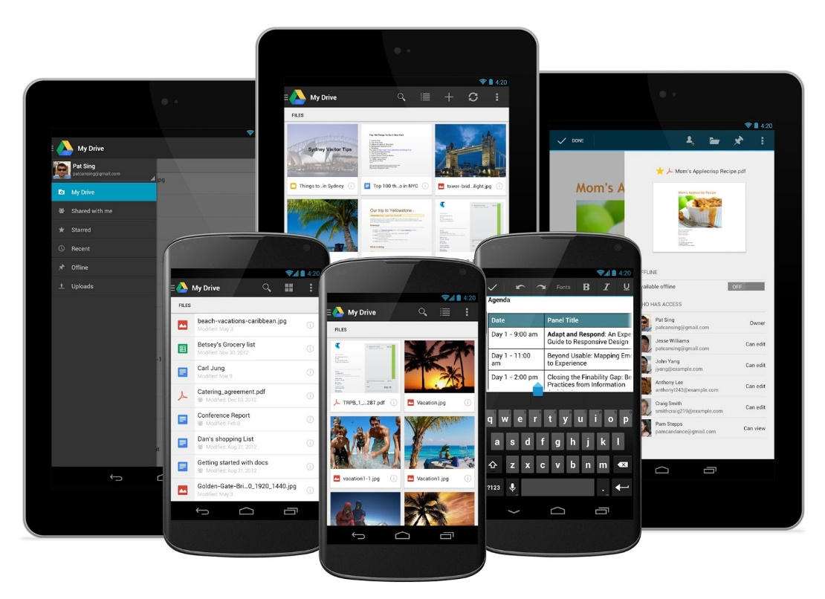
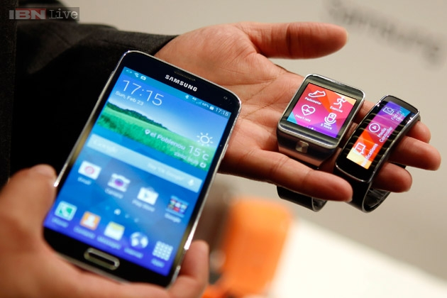
Android
Google’s mobile operating system
2008 – First Android Phone carried by T-Mobile
2010 –Android powered devices became a strong competitor with the iPhone
Content via Google Play Store
Today’s Android products include both mobile phones as well as tablets, and watches

Slide 8
Apps
2010 – Became a big year for apps with the Introduction of the iPad
“little computer programs”
Include games, barcode scanners, photo editors, book readers, document readers, social media, streaming music and movies, etc.
Apple opened its platform to outside developers to create apps for its products
Companies like Google, RIM, Verizon, Windows have created their own app marketplaces
App development has become a big industry with thousands of developers, vendors, and start-ups

Slide 9
There is an app for that….
Mobile Applications

Slide 10
There’s An App for That ®
https://www.youtube.com/watch?v=szrsfeyLzyg

Slide 11
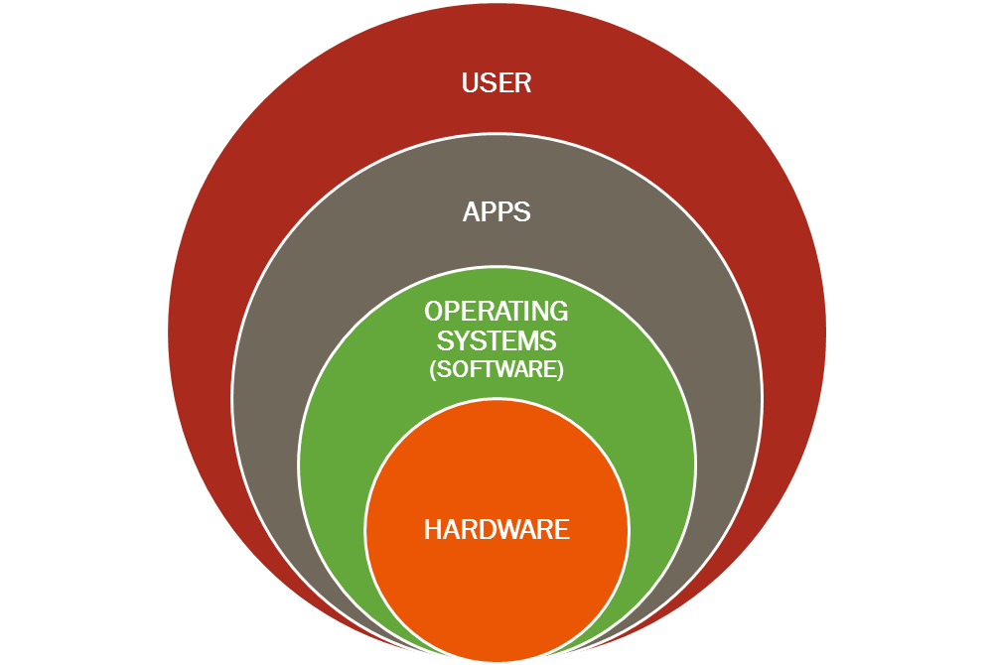
The Circle of Friends

Slide 12
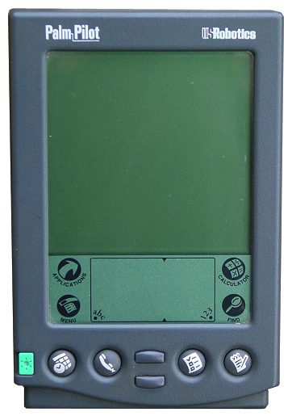
In the Beginning . . .
The Palm PDA Device
1996
16MHz Motorola processor
160x160 resolution monochrome LCD touchscreen
512kB of built-in memory
1998, Apple

Slide 13
In the Middle . . .
The Palm One Treo 600
2003
Palm/Handspring Merged
Smartphone
PalmOS 5.2.1
144MHz ARM-based CPU
32 MB of RAM
160x160 resolution color touchscreen.

Slide 14
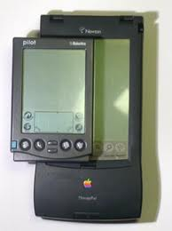
Meanwhile at the Ranch . . .
Apple’s Newton PDA Platform
1987 – 1998
Newton OS shared with Motorola, Sharp, & Digital Ocean
Preloaded w/ various APPS: Notes, Names, Dates, Productivity, Works Word Processor & 3rd Party Apps.
Turned Focus to cell phone w/PDA capabilities.

Slide 15
The Outcome . . .
Mobile Apps: Infrastructure
Patents Proliferation
Improved App Testing
Efficient Emulators
Application Stores
Platforms/Integrated development Environments
Market Awareness and Demand

Slide 16
Where Are We Today?
Rise in popularity of mobile apps driving innovation
Over 1 billion apps in existence today
Began as general productivity and information retrieval
Email, Calendar, Contacts, Weather
Now consist of apps for every need
Gaming, Banking, GPS, Order Tracking, Ticket Purchasing, Medical, Personal Finance, Real Estate, Etc.
Over 90% of apps are free

Slide 17
What’s Trending?
Consumers are spending more time on apps.
Web usage down from 31 to 22 minutes daily from 2013 to 2014
51% of digital media time spent on apps
Consumers spending four more minutes per day on the phone
App usage grew from 80% of phone use to 86% of phone use in 2014.
32%Gaming, 17% Facebook, 11% Other Social Media, 3% News
Connection speed not an obstacle (4G)

Slide 18
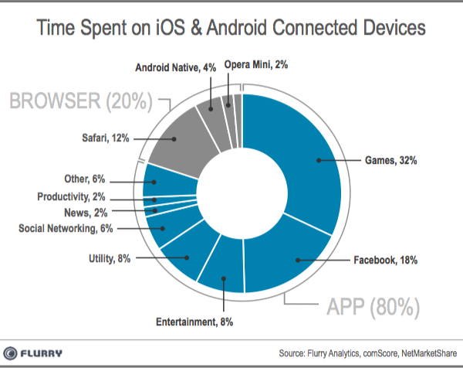
Phone Usage

Slide 19
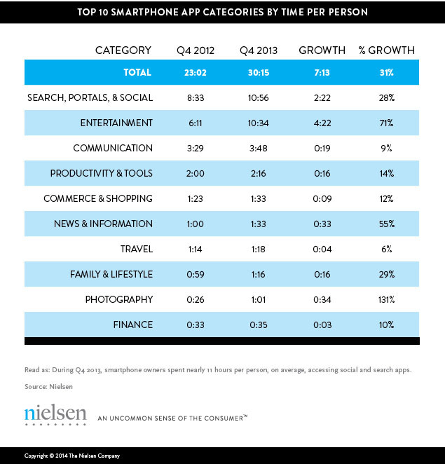

Slide 20
How Are Apps Powered?
Pre-installed, downloaded
Cloud-based apps offer most advantages
Access directly from the cloud with a mobile Web browser interface
Data on Internet rather than device
HTML5 enables caching on the handset
Offers developers flexibility and access to larger, wider markets
4G supports large scale cloud deployment and better service
Operated by the Mobile OS
Apple App Store, Google Play, Windows Phone Store, Blackberry App World
Cloud development platforms
Apple, Google, Adobe, Parse

Slide 21
Parse
mBaaS company acquired by FB in 2013 for $85M
Hosts backend services for mobile app developers
Manage identity log-ins
Push notifications
Run custom code in the cloud
Analytics
FB’s push to become relevant in mobile OS
No OS, no phones
60,000 / 60,000 developers
Food Network, Travel Channel, Armani, Etc.

Slide 22
Why Parse???
FB aims to be a leader in the mobile app environment
Early jump on fast-growing apps
App Linking – deep linking one app to another
Regain web surfing experience
Bridge unbundled apps
Seamlessly transition between apps
Lucrative “News Feed” feature

Slide 23
Media and Marketing Trends

Slide 24
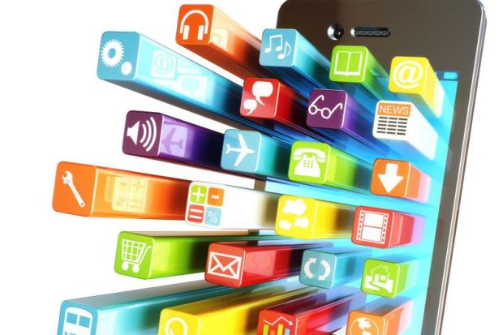
Trends in 2014 and Beyond
Location-Based Marketing
Customer-Centric Information
Cognitive Computing
Visual Influencers
Cloud Economy

Slide 25
Reaching Customers Today and In the Future
Reshaping and Rewiring the Customer Experience
Using technology to design more compelling, personally relevant, engrossing experiences that lead to lasting, productive relationships, higher levels of satisfaction and new sources of revenue.
Where Do You Start?
Web, Mobile and Social Content Enablement
Self-service and Governance
Ease of Access
Digital IP and Asset Management
Cost Reduction
Source: Deloitte

Slide 26
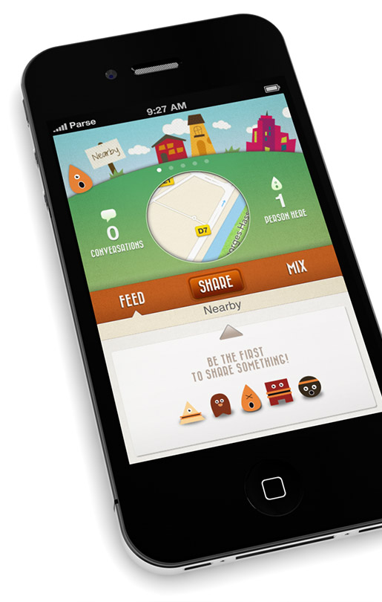
Goodbye #FOMO, Hello #FOMA

Slide 27
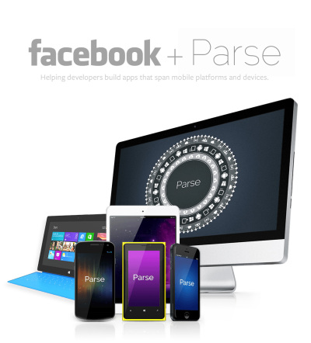
Looking Forward

Slide 28
TapCommerce

Slide 29
Parse

Slide 30
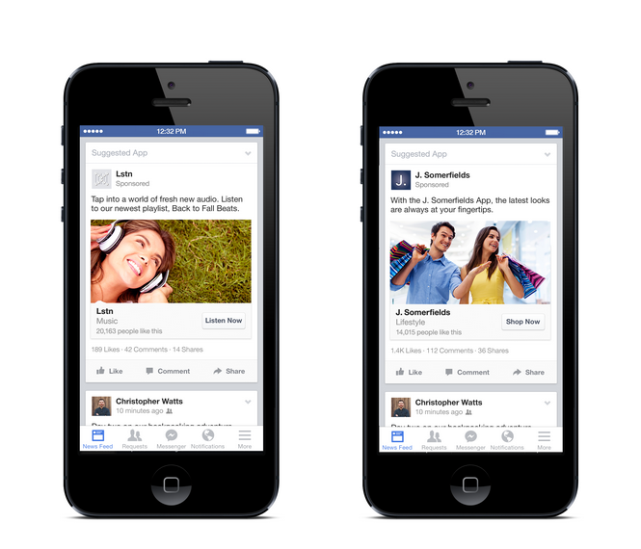
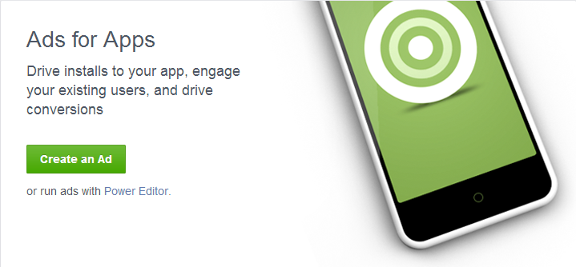
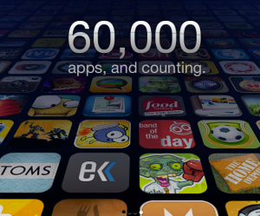
Building Revenue

Slide 31
Engaging Customers Through Apps
http://money.cnn.com/video/technology/2014/02/19/t-facebook-whatsapp-19-billion.cnnmoney/

Slide 32
Questions?

