Slide 1
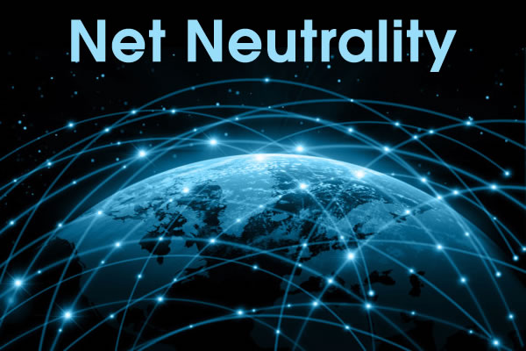
http://youtu.be/g-mW1qccn8k
Independent Case study Presenters,
BAA 607 Zarna, Kate, Daniel, Jordan.
Management Information System
Stetson School of Business and Economics

Slide 2
Introduction What is Net Neutrality?
Net Neutrality means an Internet that enables and protects free speech. It means that Internet service providers should provide us with open networks — and should not block or discriminate against any applications or content that ride over those networks. Just as your phone company cannot decide who you could call and what you say on that call, your ISP should not be concerned with what content you view or post online.
No change in speed, price, or service quality based on the type of content being accessed.
The belief that Internet service providers should treat all data that flows over their wires equally.

Slide 3
Supporters
Those in favor of network neutrality include organizations like MoveOn.org, the Christian Coalition, the American Library Association, every major consumer group, many bloggers and small businesses, and some large Internet companies like
Google
Amazon
Netflix
Yahoo
Some members of the U.S. Congress also support network
neutrality.

Slide 4
Opponents
Those who oppose network neutrality include telecommunications and cable companies who want to be able to charge differentiated prices based on the amount of bandwidth consumed by content being delivered over the Internet.
Telephone Companies
AT&T
Verizon
T-mobiles

Slide 5
Without Net Neutrality
Any of the ISPs could create a media affiliation that could deter the user from using any outside media service. e.g. Netflix
The ISP could slow down Netflix to the point where it is unusable to drive users to their own service.
Net neutrality is vital to the lives of everyone; the people, in a way, do not need to be controlled by companies to use their favorite sites.
Comcast slowed down Bit Torrent because they wanted to eliminate piracy, and limit the bandwidth that was associated with it.

Slide 6
Without Net neutrality- Worst case Scenario
Paying the ISP(Internet service provider) to access certain packages of websites.
The ISP monitors which sites you visit, and only allows the users to access the internet packages that is paid for.
Users won’t be able to access the internet without limits.
You would have to choose carefully which sites you would want to visit.
Having pay extra for a packages so you can access the site is a huge inconvenience as a student.

Slide 7
Fight for Net Neutrality
Congress enacts 1996 Telecommunications Act
telecommunications services should treat data equally and not discriminate
In the Act, FCC classified broadband internet as an “information service” instead of “telecommunications service”
That classification prevents the FCC from having the power to enforce its Open Internet Order on ISPs.

Slide 8
Fight for Net Neutrality
Verizon filed a lawsuit
Claimed FCC doesn’t have the power to enforce those rules on broadband internet providers.
DC Circuit Court of Appeals ruled in favor of Verizon
BUT said FCC DOES have the authority, but since it has chosen to classify broadband as an information service it cannot enforce open internet rules which apply only to telecommunication services.
Both the Supreme Court and Court of Appeals have stated that the FCC must reclassify broadband in order to enforce open internet rules.

Slide 9
Why Not Reclassify?
Why hasn’t the FCC reclassified?
Politics- congressional support has been slow coming, however, legislation is currently being written.
Choosing between two options:
Allow fast lanes
Be transparent about network practices
Reclassification of Broadband
Reestablish net neutrality

Slide 10
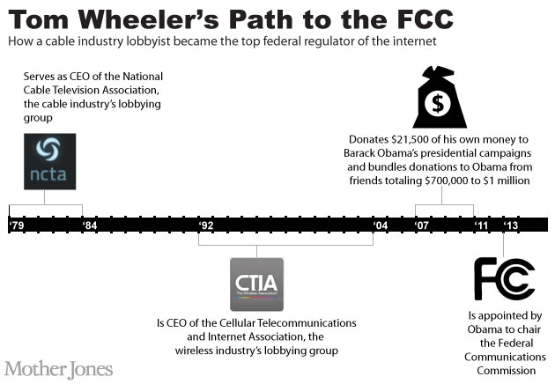
Obama to the Rescue! Right?
2007: "I'll take a backseat to no one"
2014: Obama takes a backseat. But why?

Slide 12
An ISP’s Perspective
What is an ISP?
ISP stands for Internet Service Provider
A company that provides you with access to the Internet, usually for a fee.
The most common ways to connect to an ISP are by using a phone line (dial-up) or broadband connection (cable or DSL).

Slide 13
Open Internet
The "Open Internet" is the Internet as we know it.
It's open because it uses free, publicly available standards that anyone can access and build to, and it treats all traffic that flows across the network in roughly the same way.
Promotes competition
Enables investment and innovation

Slide 14
An ISP’s Perspective
With Net Neutrality or Open Internet, ISP’s are required to:
Disclose network management practices
Disclose terms and conditions to consumers
This is a problem for ISP’s. It requires more labor and time for ISP’s.

Slide 15
ISP’s Goal
ISP’s want to be able to create Fast Lanes
Fast Lanes are paid prioritization agreements between an ISP and a web content provider
Fast Lanes are good for ISP’s because they allow for ISP’s to charge content providers more money for more intensive data moving sites, such as NetFlix

Slide 16
Threat to ISP’s
Title II reclassification
The FCC is looking into reclassifying ISP’s as utilities, which would put much more regulation on ISPS.
This would cause ISP’s to charge more for service due to increased labor numbers as well as allowing the FCC to further restrict fast lanes

Slide 17
Threat to ISP’s
Online Competition and Consumer Choice Act
Democrats have proposed a bill that require FCC to use whatever authority it sees fit to ban paid prioritization agreements
They believe that this legislation will allow internet to be more conducive for free thought and creativity.
This bill is most likely not going to get through the Senate, but ISP’s need to keep an eye on this

Slide 18
ISP’s Rights
Classified as Information service, not telecommunications service, ISP’s cannot be regulated in the same way by FCC
They are exempt from being required to follow common carrier rules
Common carriers cannot discriminate based on content

Slide 19
ISP’s Rights

Slide 20
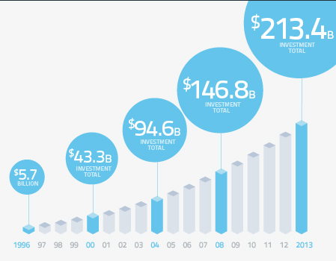
ISP’s Rights

Slide 21
ISP’s Rights
Internet Service Providers believe that the $213.4B that they have invested in internet infrastructure gives them the right to choose how they distribute it.
They have even threatened to decrease speed/number of upgrades if FCC reclassify ISP’s as utilities
Capitalist country- makes it hard to disagree with ISP’s

Slide 22
Effects on Content Providers
Choose between the fast and slow lanes of service
Small businesses disproportionately effected
Creates barrier to entry
Growth and innovation stifled
Pay extra fees to ensure content reaches consumers
Netflix has paid a premium to be available via Comcast at faster speeds

Slide 23
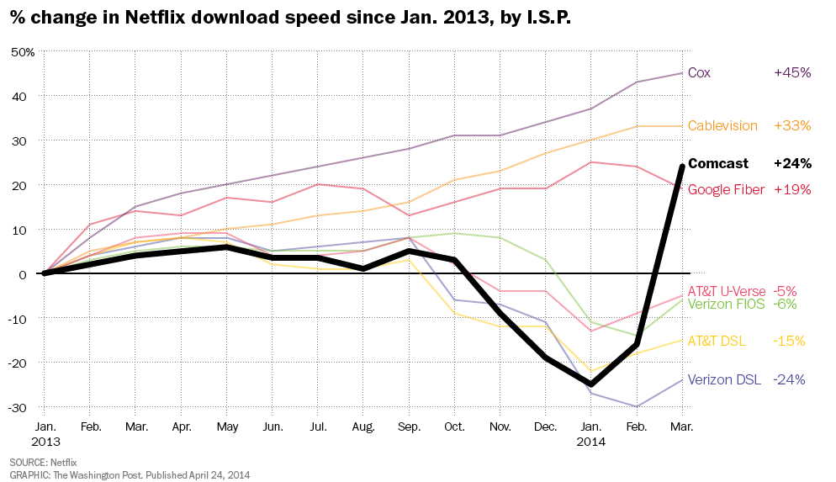
NETFLIX vs. Comcast

Slide 24
Effects on Content Providers
Inconsistent website/webservice performance
ISP’s can block or interfere with any content they choose to
Political articles/ads
Competitors products/services
“Calls to action”: Tweets, Facebook posts, etc.
Will lead to exclusive deals
Content providers may seek exclusive deals with ISP’s to ensure consistent content delivery

Slide 25
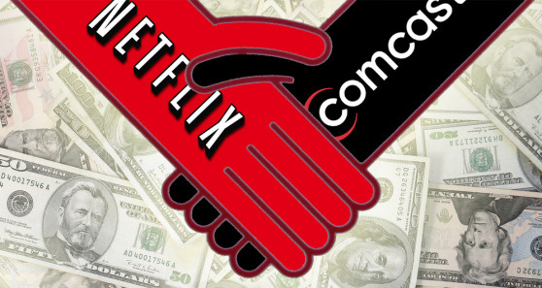
The Rise of Exclusive Deals
Verizon forcing you to use MapQuest
Bing as Comcast’s “preferred” search engine
AT&T as only source for Google and YouTube but no Facebook ☹

Slide 26
Effects on Competition
Internet will become an unlevel playing field
Lack of competition
Content providers have little choice but to pay higher fees for consistent service
Large firms will pay for better access
Smaller firms will be unable to compete due to pricing pressures or content blocking
The “next big thing” may never make it to consumers
Consumers left with less choice
Fees passed onto the consumer

Slide 27
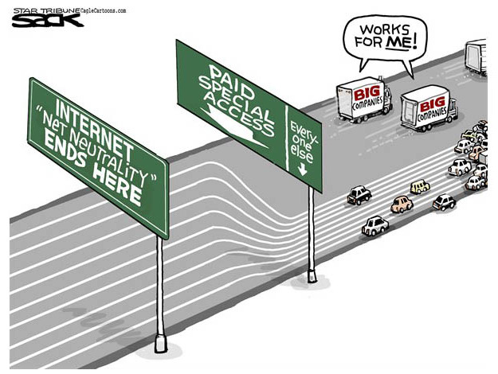
Effects on Competition

Slide 28
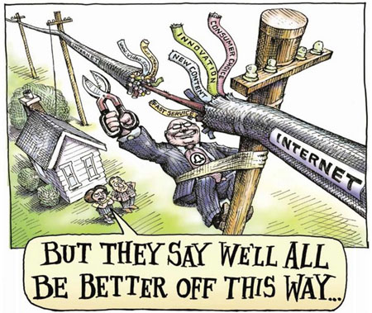
Why This Affects You
Degraded service
Services that consumers use w/o paying a special fee to ISPs will not work as well
Excluded from the “fast lane”
Consumers will lose control of the internet/ISP will control the content consumer will see

Slide 29
Why This Affects You
Higher costs
Fees will be more expensive
NYU study: NN could cost Americans 500,000 jobs and $62 billion over the next 5 years
Pass the fee on to users
The international market research firm Frost & Sullivan found net neutrality regulations would likely pass on to the consumer up to $55 per month in additional costs
Puts consumers in the middle of disputes between large companies over service fees

Slide 30
Why This Affects You
Uneven service: Faster service for some
Operating under the assumption that paid partnerships between ISPs and content providers will equal faster and a better consumer experience
Local media outlet: unlikely to be able to pay to be a part of the “fast lane”
Consumers may leave before the multimedia content evens loads
Broadband service could be tiered
Platinum package-access everything the internet has to offer and a guaranteed a certain quality
Lower price point-your access and quality could be compromised
Gives ISPs the power to impair or improve your access to website depending on how it benefits them

Slide 31
Why This Affects You
Greater technological divide by income and demographics
Stand to loose much more than the loss of cheap streaming of movies and TV shows
Content providers that provide educational opportunities or patient health communication: unable to share content
Single mother who can no longer take her online college courses
Child in a rural area loses the ability to video conference with his/her physician
Community media outlet in the inner city that is charged more to distribute the news

Slide 32
Any Questions?

