Slide 1
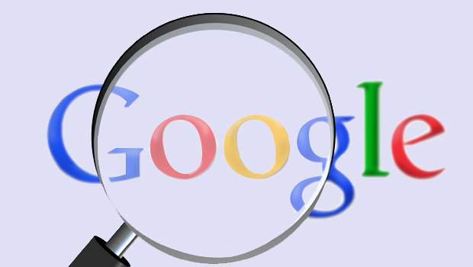
Google Privacy Policy
Karen Tao

Slide 2
Overview
Information Google collected
Device information updates
Cookies
How does Google collect information
Information we gave
From use of Google’s services
How Google uses information it collects
20120301, use across all of the services it offer
20160628, DoubleClick

Slide 3
New privacy policy since March 1, 2012
January 24th 2012 afternoon Google announced it was making sweeping changes to its privacy policy beginning March 1.
Google is able to pair information it collects on its email service with information it collects on its search service to really target its advertising
Users are tracked across services.
Users can't opt out.

Slide 4
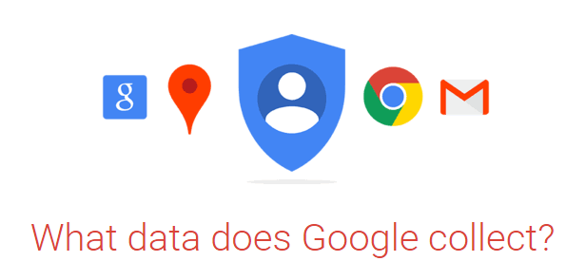
Information collected
Device information
Login information
Location information
Unique application information
Local storage
Cookies and similar technologies

Slide 5
Device Information
Before 20120301

Slide 6
Device Information
20120301
20141219

Slide 7
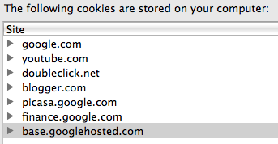
Cookies

Slide 8
Collect information in the following ways
Information you give us. For example, many of our services require you to sign up for a Google Account. When you do, we’ll ask for personal information, like your name, email address, telephone number or credit card to store with your account.
If you want to take full advantage of the sharing features we offer, we might also ask you to create a publicly visible Google Profile, which may include your name and photo.

Slide 9
From the use of Google’s services
We collect information about the services that you use and how you use them, like when you watch a video on YouTube, visit a website that uses our advertising services, or view and interact with our ads and content.

Slide 10
How Google uses information it collects
Before 2/28/2012

Slide 11
20120301
We use the information we collect from all of our services to provide, maintain, protect and improve them, to develop new ones, and to protect Google and our users. We also use this information to offer you tailored content – like giving you more relevant search results and ads.
We may use the name you provide for your Google Profile across all of the services we offer that require a Google Account. In addition, we may replace past names associated with your Google Account so that you are represented consistently across all our services. If other users already have your email, or other information that identifies you, we may show them your publicly visible Google Profile information, such as your name and photo.
We may combine personal information from one service with information, including personal information, from other Google services – for example to make it easier to share things with people you know. We will not combine DoubleClick cookie information with personally identifiable information unless we have your opt-in consent.

Slide 12
We may use the name you provide for your Google Profile across all of the services we offer that require a Google Account.
we may replace past names associated with your Google Account so that you are represented consistently across all our services.
If other users already have your email, or other information that identifies you, we may show them your publicly visible Google Profile information, such as your name and photo.

Slide 13
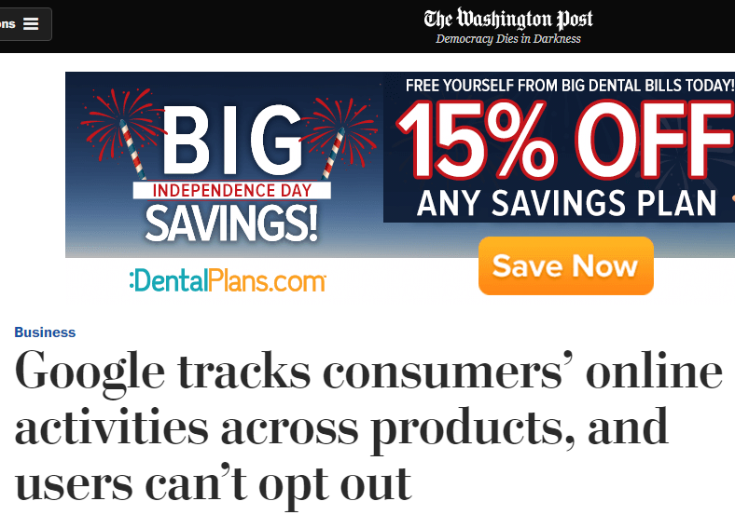

Slide 14
DoubleClick update
August 19,2015
“We will not combine DoubleClick cookie information with personally identifiable information unless we have your opt-in consent.”
June 28, 2016
“Depending on your account settings, your activity on other sites and apps may be associated with your personal information in order to improve Google’s services and the ads delivered by Google.”
This activity might come from your use of Google products like Chrome Sync or from your visits to sites and apps that partner with Google. Many websites and apps partner with Google to improve their content and services. For example, a website might use our advertising services (like AdSense) or analytics tools (like Google Analytics).
These products share information about your activity with Google and, depending on your account settings and the products in use (for instance, when a partner uses Google Analytics in conjunction with our advertising services), this data may be associated with your personal information.

Slide 15
Example
This activity might come from your use of Google products like Chrome Sync or from your visits to sites and apps that partner with Google. Many websites and apps partner with Google to improve their content and services. For example, a website might use our advertising services (like AdSense) or analytics tools (like Google Analytics).
These products share information about your activity with Google and, depending on your account settings and the products in use (for instance, when a partner uses Google Analytics in conjunction with our advertising services), this data may be associated with your personal information.

Slide 16
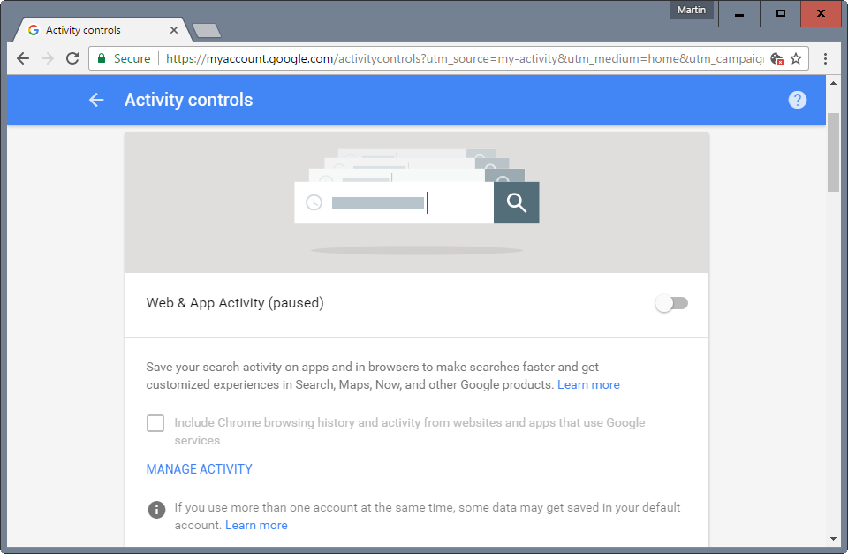
Not opt-in

Slide 17
Thank you

