Slide 1
An Overview of Google’s Privacy Policy: Key Considerations & Main Points
Marcy Pentoney
BA 625: Privacy Law and Policy

Slide 2
Key Considerations
Published April 17, 2017
Short – 5 pages
Use of the word “may” 44 times, i.e. “Google may do XYZ…”
Generally reflects the FIPPs, though vague at times
Positioning as a benefit to user/consumer
“You’re in control”
“This improves your experience”
“Offer better services”
User-friendly website with examples
https://privacy.google.com

Slide 3
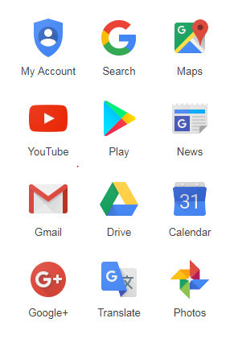
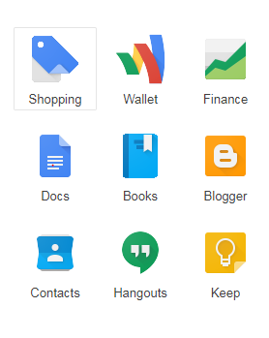
Google Entities Covered Under the Policy
Notes:
Our Privacy Policy applies to all of the services offered by Google Inc. and its affiliates, including YouTube, services Google provides on Android devices, and services offered on other sites (such as our advertising services), but excludes services that have separate privacy policies that do not incorporate this Privacy Policy.
Our Privacy Policy does not apply to services offered by other companies or individuals, including products or sites that may be displayed to you in search results, sites that may include Google services, or other sites linked from our services. Our Privacy Policy does not cover the information practices of other companies and organizations who advertise our services, and who may use cookies, pixel tags and other technologies to serve and offer relevant ads.

Slide 4
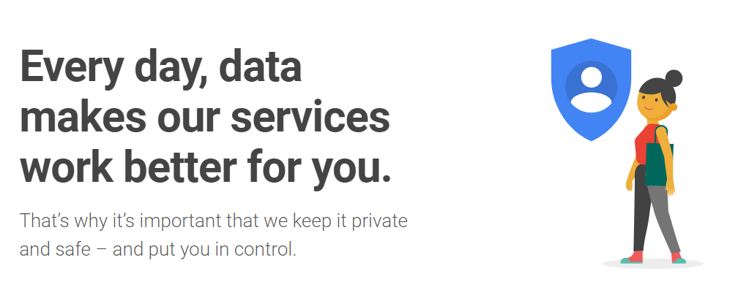
https://privacy.google.com

Slide 5
https://privacy.google.com/your-data.html

Slide 6
https://privacy.google.com/take-control.html

Slide 7
https://privacy.google.com/your-security.html

Slide 8
https://privacy.google.com/how-ads-work.html

Slide 9
https://privacy.google.com/safer-internet.html

Slide 10
Google Claims to Put Consumers in the Driver’s Seat
“When you share information with us, for example by creating a Google Account, we can make those services even better – to show you more relevant search results and ads, to help you connect with people or to make sharing with others quicker and easier. As you use our services, we want you to be clear how we’re using information and the ways in which you can protect your privacy.”

Slide 11
Information Google Collects
Information you give us
Name, email address, telephone number of credit card, photo
Information we get from your use of our services
Services you use and how you use them
Videos on YouTube
Interactions with Google ads
Interactions with websites that use Google advertising services

Slide 12
Information Google Collects
Device information
Hardware model
Operating system version
Unique device identifiers
Mobile network information, including phone number
“May” associate device ID and/or phone number with your Google account
Log information
Details of how you used our service, such as your search queries
Telephony log information like your phone number, calling-party number, forwarding numbers, time and date of calls, duration of calls, SMS routing information and types of calls
IP address
Device event information such as crashes, system activity, hardware settings, browser type, browser language, the date and time of your request and referral URL
Cookies that may uniquely identify your browser or your Google account

Slide 13
Information Google Collects
Location information
“When you use Google services, we may collect and process information about your actual location. We use various technologies to determine location, including IP address, GPS, and other sensors that may, for example, provide Google with information on nearby devices, Wi-Fi access points and cell towers.”
Unique application numbers
Information about your installation of apps and app version number
Information about app updates and operating system

Slide 14
Information Google Collects
Local storage
“We may collect and store information (including personal information) locally on your device using mechanisms such as browser web storage (including HTML 5) and application data caches.”
Cookies and similar technologies
“We and our partners use various technologies to collect and store information when you visit a Google service, and this may include using cookies or similar technologies to identify your browser or device. We also use these technologies to collect and store information when you interact with services we offer to our partners, such as advertising services or Google features that may appear on other sites. Our Google Analytics product helps businesses and site owners analyze the traffic to their websites and apps. When used in conjunction with our advertising services, such as those using the DoubleClick cookie, Google Analytics information is linked, by the Google Analytics customer or by Google, using Google technology, with information about visits to multiple sites.”

Slide 15
How Google Uses Your Information
To provide, maintain, protect and improve services
To develop new services
To protect Google and our users
To offer you tailored content – like more relevant search results and ads

Slide 16
How Google Uses Your Information
“We may use the name you provide for your Google Profile across all of the services we offer that require a Google account.”
“We will respect the choices you make to limit sharing or visibility settings in your Google account.”
“We may combine personal information from one service with information, including personal information, from other Google services – for example to make it easier to share things with people you know. Depending on your account settings, your activity on other sites and apps may be associated with your personal information in order to improve Google’s services and the ads delivered by Google.”

Slide 17
How Google Uses Your Information
“When you contact Google, we keep a record of your communication to help solve any issues you might be facing. We may use your email address to inform you about our services, such as letting you know about upcoming changes or improvements.”
“We use information collected from cookies and other technologies, like pixel tags, to improve your user experience and the overall quality of our services.”
“Our automated systems analyze your content (including emails) to provide you personally relevant product features, such as customized search results, tailored advertising, and spam and malware detection.”

Slide 18
How Google Uses Your Information
“We will ask for your consent before using information for a purpose other than those that are set out in this Privacy Policy.”
HOW?

Slide 19
Transparency and Choice
“People have different privacy concerns. Our goal is to be clear about what information we collect, so that you can make meaningful choices about how it is used.”
Users can review, update and export data settings and saved information (for certain services)
Users can disable certain information from being stored in cookies
…but, remember, if you make these changes your Google services may not function properly.

Slide 20
Information You Share
“We aim to provide you with access to your personal information. If that information is wrong, we strive to give you ways to update it quickly or to delete it – unless we have to keep that information for legitimate business or legal purposes.” (Like what?)
“Where we can provide information access and correction, we will do so for free, except where it would require a disproportionate effort.” (Like what?)
“After you delete information from our services, we may not immediately delete residual copies from our active servers and may not remove information from our backup systems.”

Slide 21
Information Google Shares
“We do not share personal information with companies, organizations and individuals outside of Google unless one of the following circumstances applies:”
With your consent (opt-in consent for sharing of any sensitive personal information)
With domain administrators
For external processing (affiliates or other trusted businesses)
For legal reasons
“We may share non-personally identifiable information publicly and with our partners – like publishers, advertisers or connected sites.”
“If Google is involved in a merger, acquisition or asset sale, we will continue to ensure the confidentiality of any personal information and give affected users notice before personal information is transferred or becomes subject to a different privacy policy.” (Toysmart?)

Slide 22
Information Security
“We work hard to protect Google and our users from unauthorized access to or unauthorized alteration, disclosure or destruction of information we hold.”
Encryption using SSL
Two step verification option for account access
Safe browsing feature in Chrome
Regular review of security measures to protect against unauthorized access
Restrict access to personal information to employees, contractors and agents who need to know that information in order to process it for us

Slide 23
Compliance
“We regularly review our compliance with our Privacy Policy. We also adhere to several self regulatory frameworks, including the EU-US and Swiss-US Privacy Shield Frameworks.”
“Google is subject to the investigatory and enforcement powers of the US Federal Trade Commission (FTC).”
Reality: FTC enforcement results in fines that are pocket change to Google

Slide 24
Changes to the Privacy Policy
“Our Privacy Policy may change from time to time. We will not reduce your rights under this Privacy Policy without your explicit consent.” (How?)
“We will post any privacy policy changes on this page and, if the changes are significant, we will provide a more prominent notice (including, for certain services, email notification of privacy policy changes).”
“We will also keep prior versions of this Privacy Policy in an archive for your review.”
Onus is on the user to be aware and track changes

Slide 25
Thank You

