Slide 1
Privacy Law
Facebook
Shiwen(Sherry) Liu

Slide 2
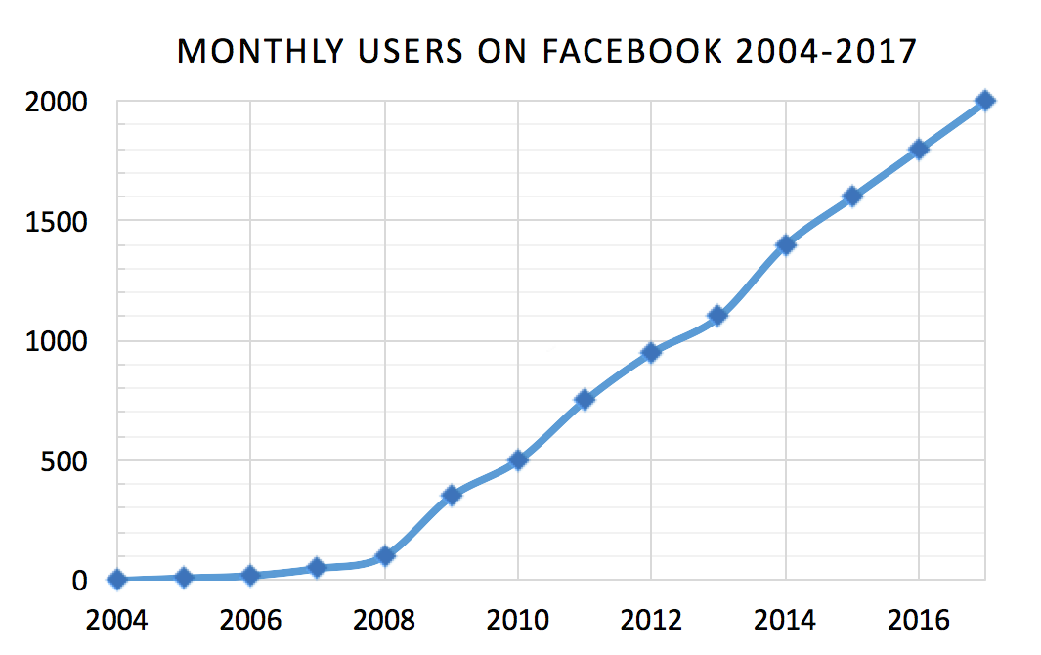
Social networking website:
www.facebook.com
• Origins in 2004 created by
Mark Elliot Zuckerberg

Slide 4
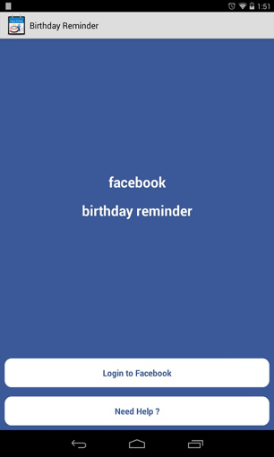
Facebook “Platform”(2007)
• Enables third parties to run (Games,etc.)
• “Platform Applications”:
Access to profile information either user
or user’s friend authorization.
e.g. Provide friend’s Birthday reminder
even if friends never authorized the application

Slide 5
Profile Privacy Page (2009)
• Profile Privacy setting:
“Only Friends” or “Friends of Friends”
• “Applications” “Apps” or “Applications and Websites”

Slide 6
Privacy Policy changed (2009)
• “Publicly available”(“PAI”)
• “the December Privacy Changes” :
• No longer restrict the visibility of pic and pages
• All prior user choices to do so were overridden

Slide 7
Privacy Policy changed (2009)
• An introductory page:
We’re making some changes to give you more control of your information and help you
stay connected. We’ve simplified the Privacy page and added the ability to set privacy
on everything you share, from status updates to photos.
• Privacy update pages:
Facebook’s new, simplified privacy settings give you more control over information
you share. We’ve recommended settings below, but you can choose to apply your old
settings to any of the fields.
A conformation page, which summarized the user’s updated Privacy settings.

Slide 8
PAI threats to users’ safety
• User’s page is visible to public
e.g. Exposing controversial political views or sensitive information to third parties.
• User’s friend List became visible to anyone
e.g. Reveal user’s sexual orientation, or business relationship to third parties
• User’s Profile Photo divulged

Slide 9
“Ads” from third-parties on web site
• Facebook may use information in your profile without identifying
you as an individual to third parties.
• Still others asked to be opted-out of having their information shared
with advertisers.

Slide 11
“Ads” from third-parties on web site

Slide 12
User profile/personal timeline (2011)

Slide 13
Criticisms and controversies
• Threats Internet Privacy
• Use of a widespread "like" button on third-party websites tracking
users
• Indefinite records of user information
• Automatic facial recognition software
• Employer-employee account disclosure in the workplace

