Slide 1
Facebook privacy policy
Ibrahim Kante
Dr. Blanke

Slide 2
Background
Facebook is an online social media and social networking. It can be accessed from any device with internet connection.
It was launched on February 4, 2004 by Mark Zuckerberg and some of his fellow Harvard students.
Facebook is very successful and is worth billions of dollars from companies’ ads.
Its stock price is $149.60 as of today. (From Yahoo Finance)

Slide 3
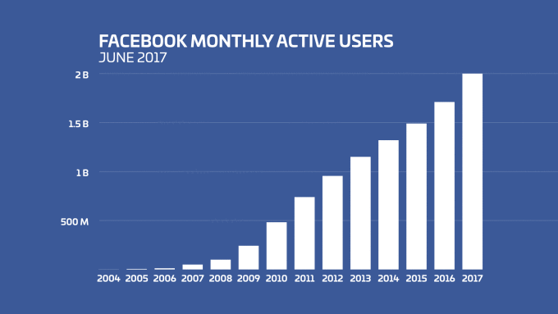
Background continued
Number of users increased from almost nothing in 2004 to 2 billion in 2017.
With this huge number of users around the world, privacy becomes a main concern.

Slide 4
Communication
Facebook collects the content all type of messages or communication between users, including photo and video.
They also collect information about those messages such as the location of a photo or the date a messages has been sent.

Slide 5
Activity
Facebook records what we do on its website, the types of content we view, the pages we visit, the posts we like, the frequency and duration of those activities to determine our interests.
They also collect information from our web history using cookies.
Ex: After searching for a certain article, we see ads
about that article on Facebook.
Cookies are tracking us whether we are logged in or not.

Slide 6
Credit card information
When using services for purchases or any financial transaction, Facebook collects information about the purchase or transaction, which includes card information and personal identifiable information.
“We may share your Personal Information with our parent company Facebook, Inc. to process your payment; for maintenance of your payment account; or to detect, prevent, or otherwise address fraud, security, or technical issues”.
“We may need to share your Personal Information under certain circumstances: so we can offer you the best service possible, to run our business, or to comply with legal requests”.

Slide 7
Information from friends
Facebook also collects information about us from others when they send us a message, tag us in a photo, or share a photo of us.
When posting something, we can choose to share it with only friends of friends. However, those friends can share it, giving access to everyone to see it.

Slide 8
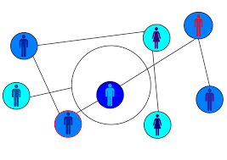
Information about friends
Facebook collects information about the people and groups we are connected to and communicate the most with. They also record how we interact with them.
They collect information about people when we upload, synch, or import address books.
(Information about people can include name, phone number, email, birthday, and address)

Slide 9
Device information
Information from computers, phones, and all devices that we use to access Facebook or Facebook-owned applications are also collected.
Some of the device information collected are operating system, settings, battery and signal strength, device location, mobile operator, internet provider, browser type, IP address, language and time zone.

Slide 10
Location
Facebook tracks our phone’s location and uses it to recommend friends we might know.
Example: Classmate

Slide 11
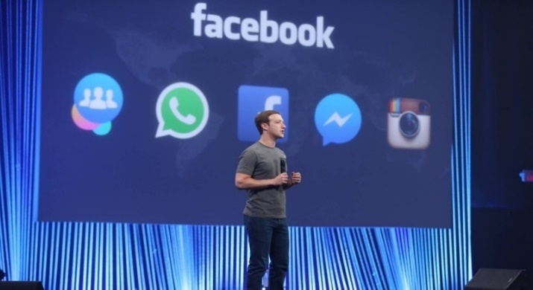
Websites and apps that use Facebook
Facebook collects information when we use websites and apps that it partners with.
Ex: Log in with Facebook account on Hulu instead of creating an account.
They also receive our information from companies that they own such as Instagram, Messenger, and WhatsApp.

Slide 12
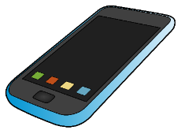
Access cellphone’s data
By installing Facebook app on mobile phone and accepting the terms, we give Facebook permission to:
read and add our calendar
read and write our contacts
read text messages and download files without notification on android phones

Slide 13
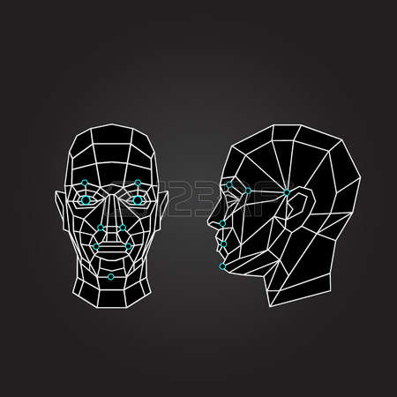
Faceprint data
When posting a picture, Facebook automatically suggest to tag people that are on the picture because they scan and store our facial features without our consent.

Slide 14
Deactivate and delete an account
When deactivating an account, profiles are not accessible but all collected information are kept. User can reactivate the account anytime.
When deleting an account, it takes up to 90 days to delete all data stored and user cannot regain access to it. However, they say some material may remain in their database.

Slide 15
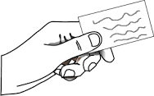
Information sharing
All information about us that Facebook collects are shared with third party companies such as vendors, service providers, research and surveys conductors.
Ex: age, sex, location, and interest.
They may also share personally identifiable information with our permission.

Slide 16
Conclusion
Facebook collects all type of information about us. They get data from the contents of our messages, our posts, and also from posts that we are tagged in.
Information we upload are there forever because Facebook keeps data even for a deleted account.
Therefore, we have to be careful and selective about what we post to keep our privacy.

