Slide 1
Apple Privacy Policy
As of: 12 September 2016
Cassian Nunez

Slide 2
Agenda
Collection and use of personal information
Collection and use of non personal information
Cookies and other Technology
Disclosure to third parties
Children and Education
Third-Party Sites and Services
International Users
Location based services

Slide 3
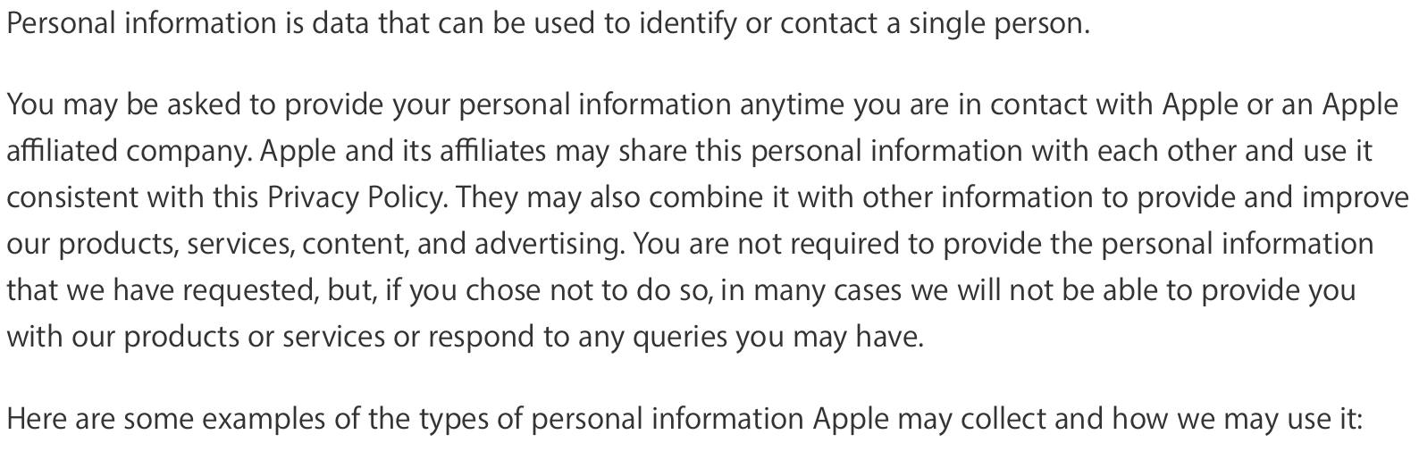
Collection and Use of Personal Information

Slide 4
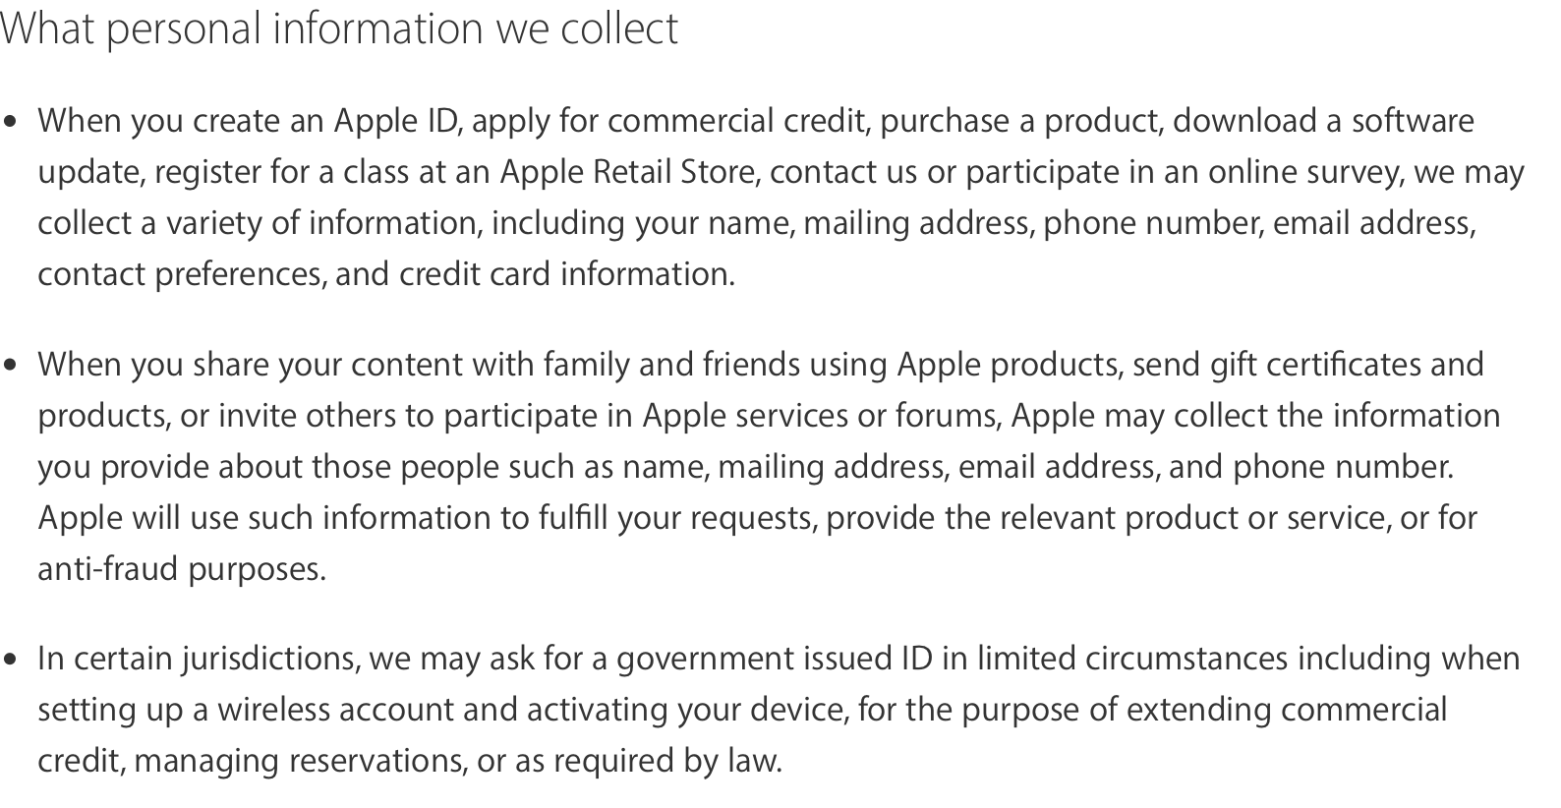
Collection of Personal Information
Examples

Slide 5
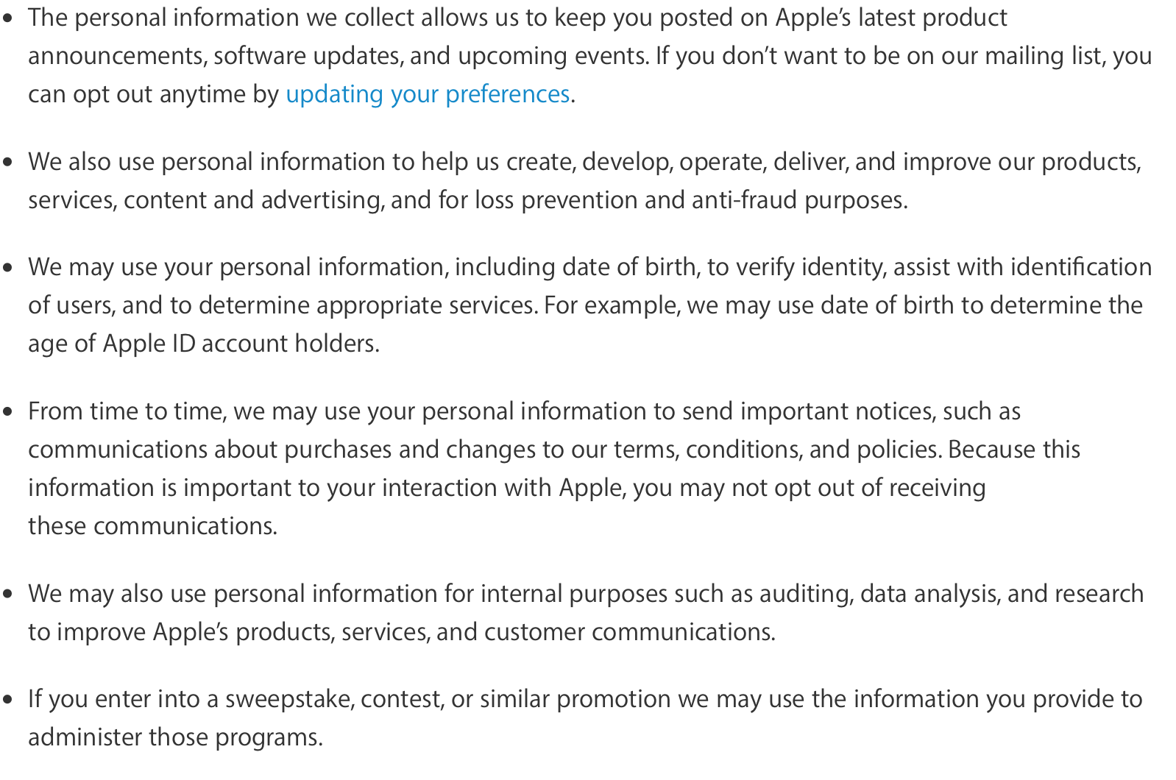
Use of Personal Information

Slide 6
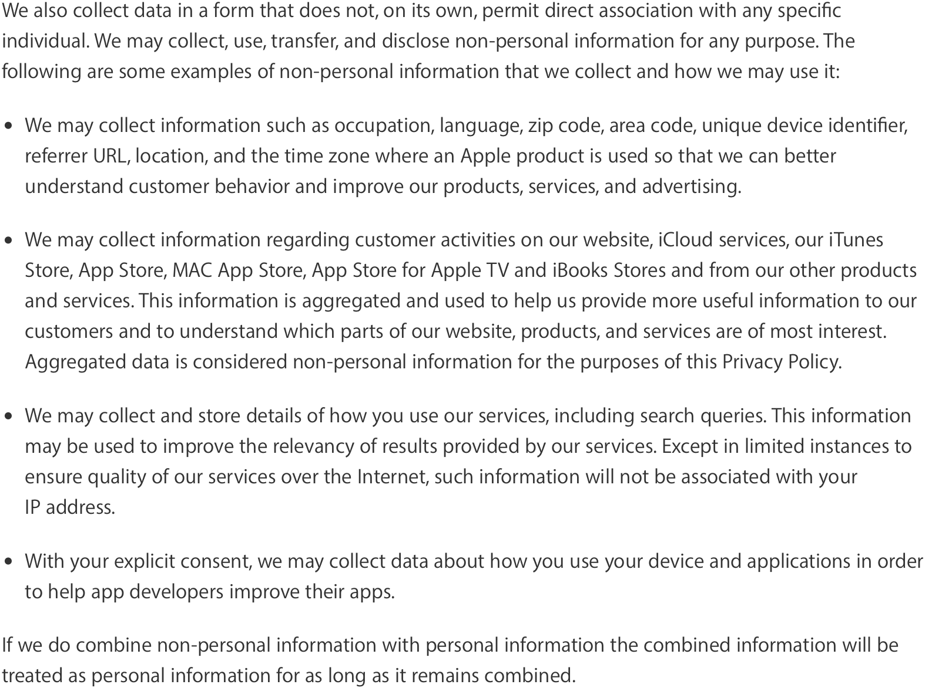
Collection and Use of Non- Personal Information

Slide 7
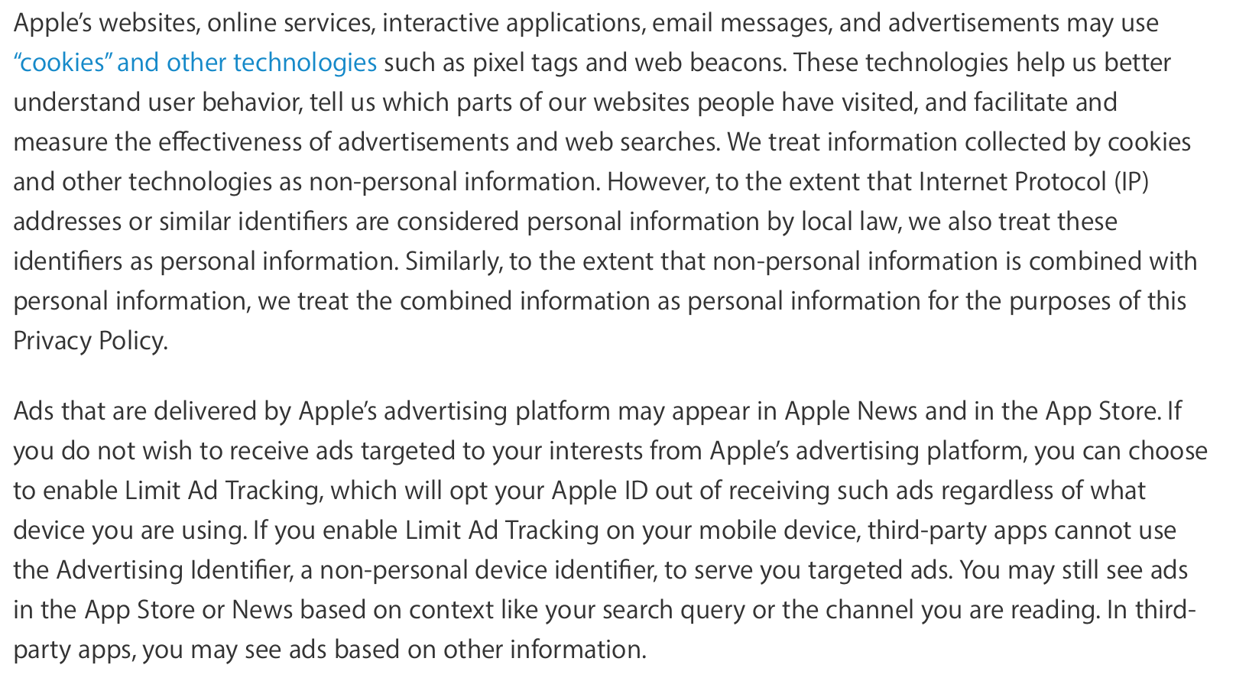
Cookies and other Technologies

Slide 8
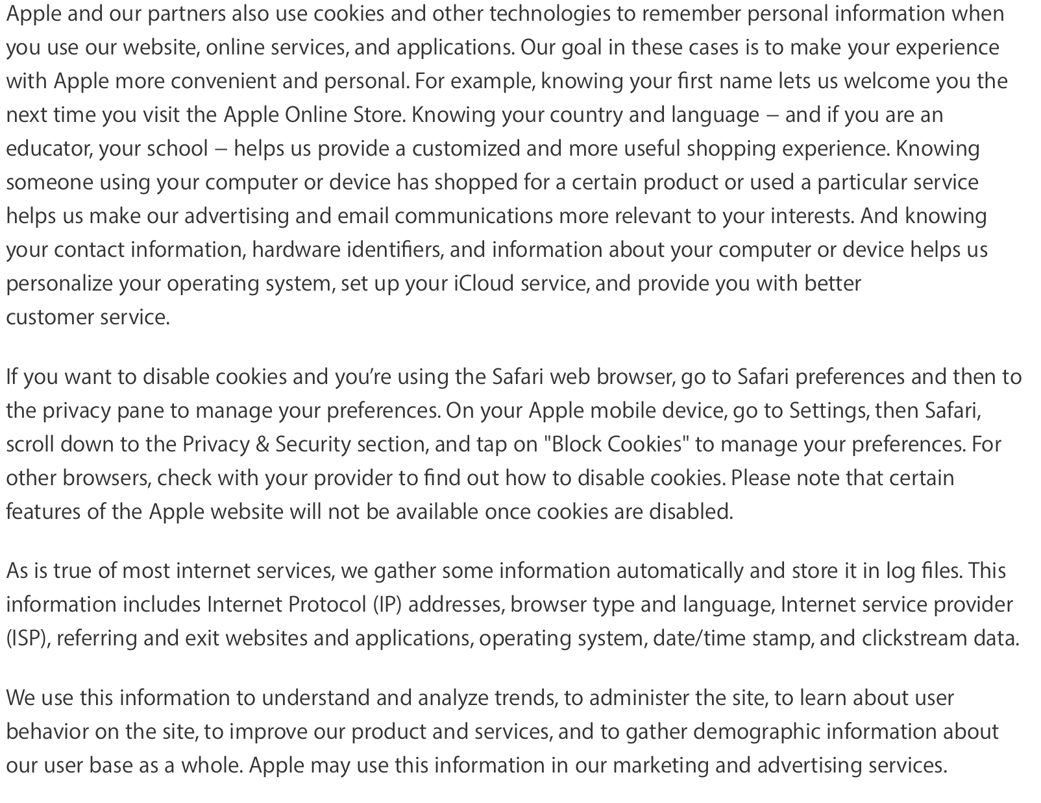
Cookies and other Technologies

Slide 9
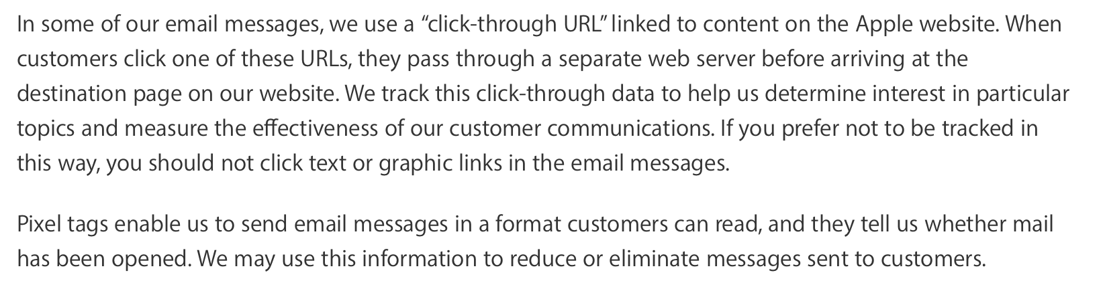
Cookies and other Technologies

Slide 10
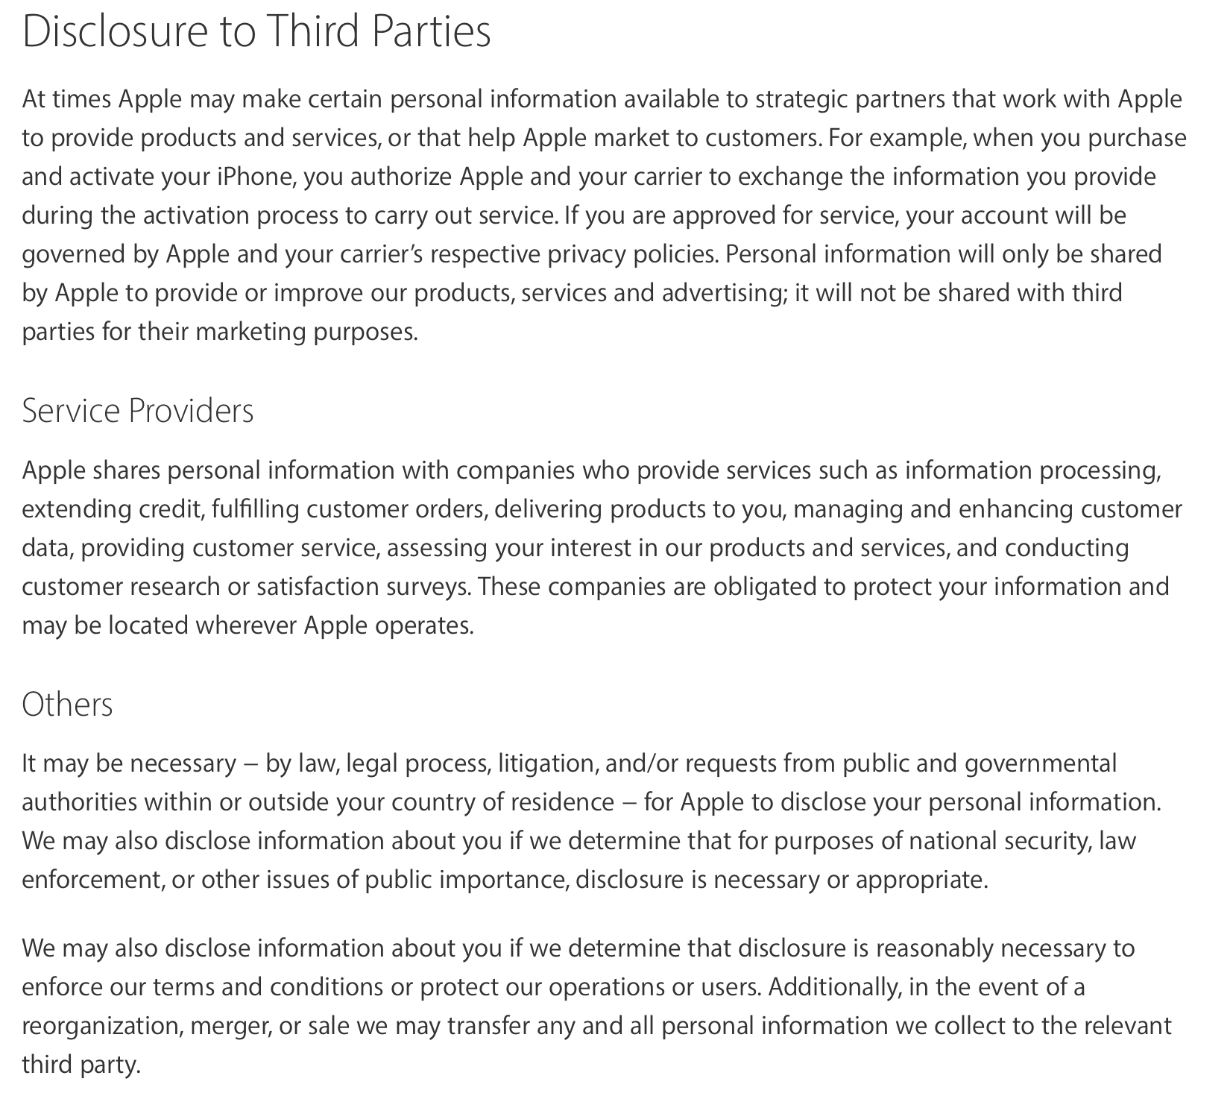
Disclosure to Third Parties

Slide 11
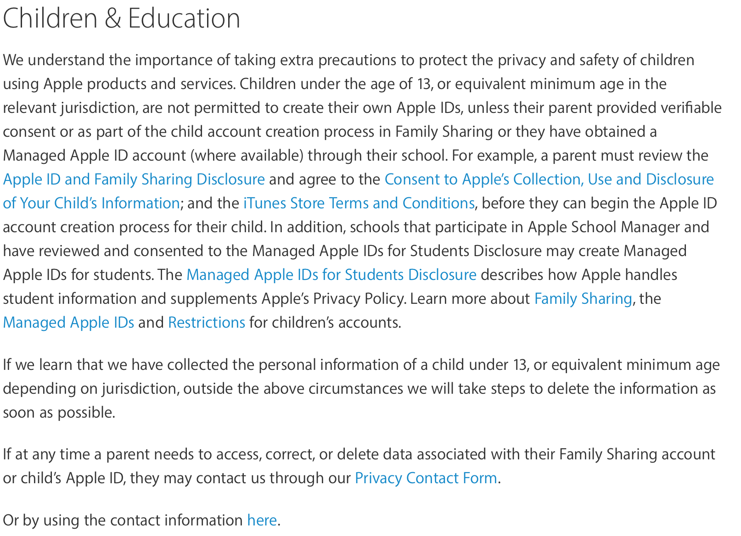
Children and Education

Slide 12
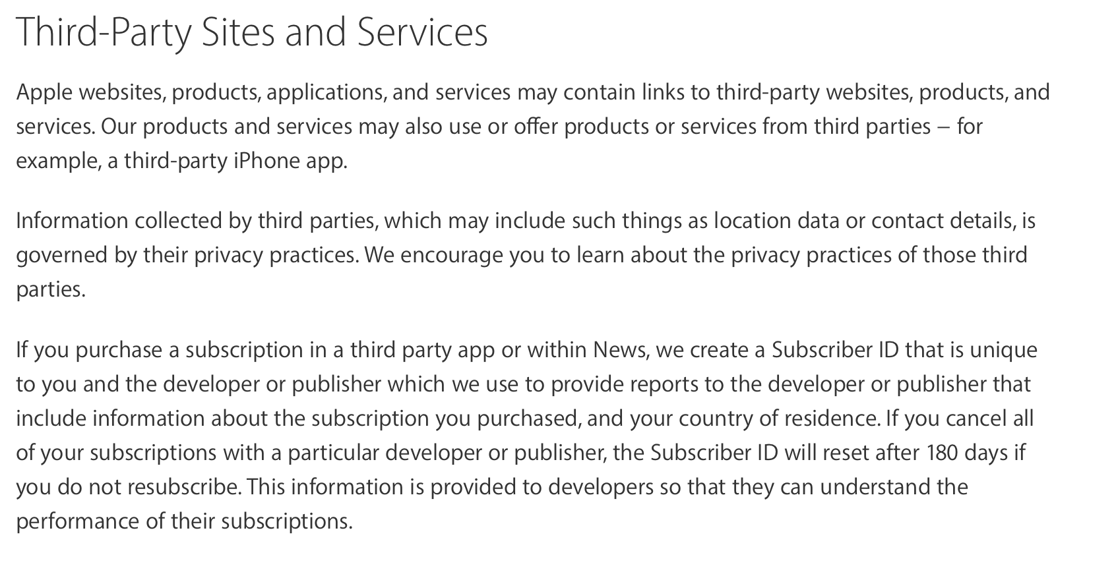
Third-Party Sites and Services

Slide 13
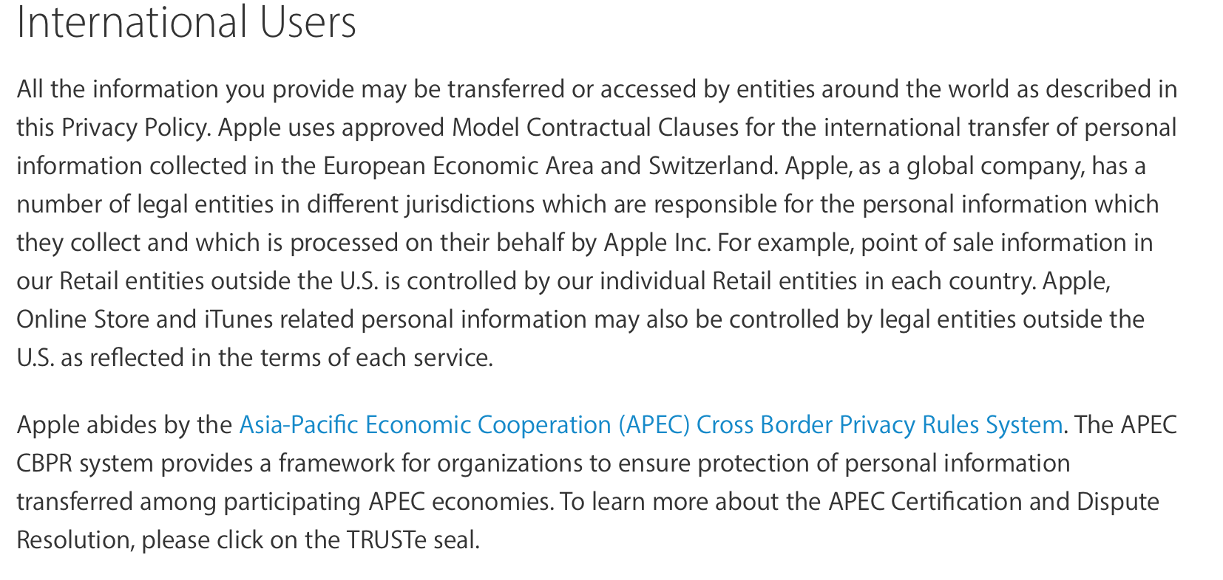
International Users

Slide 14
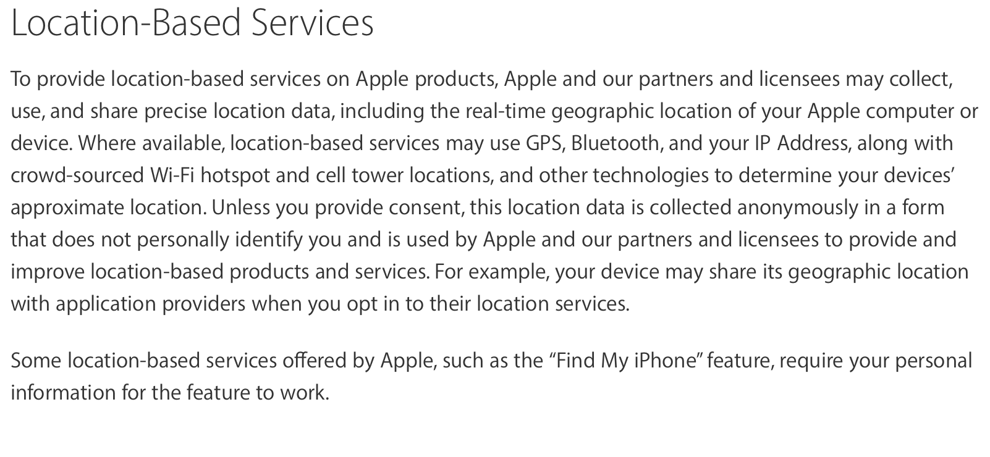
Location Based Services

Slide 15
Commitment to Privacy
To make sure your personal information is secure, we communicate our privacy and security guidelines to Apple employees and strictly enforce privacy safeguards within the company.
Apple’s commitment to privacy summed up in a sentence

Slide 16
Summary
Collection and use of personal information
Collection and use of non personal information
Cookies and other Technology
Disclosure to third parties
Children and Education
Third-Party Sites and Services
International Users
Location based services

