Slide 1
Jay z, amazon and privacy intrusion
Ben Miller

Slide 2
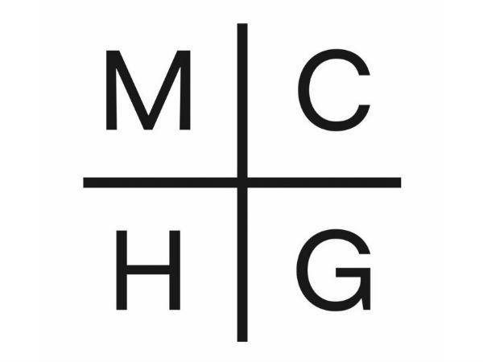

Slide 3
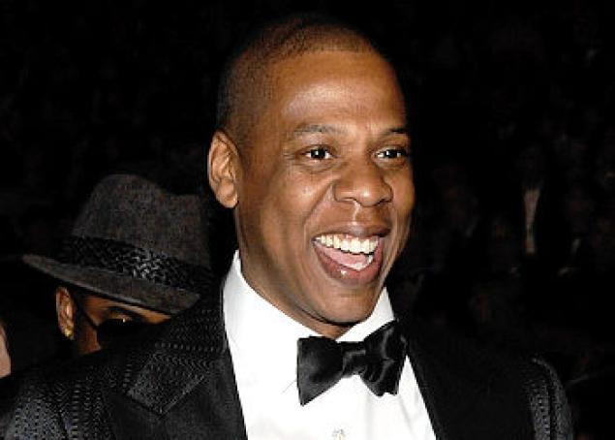
Shawn “Jay Z” Carter
Rapper, Producer, Entrepreneur, Investor and Sports Agent
Worth nearly $500 Million
Arguably the most successful hip hop artist of all time with over 50 million albums sold worldwide

Slide 4
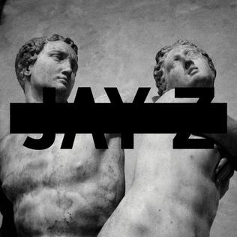
The Album – MC | HG
Jay Z’s 12th studio album
Debuted #1 on Billboard top 200
Made platinum status the first day (1,000,000 copies sold) due to deal with Samsung
Released for retail July 8th, but Samsung users could get exclusive access on July 4th if they purchased an app for $5

Slide 5
Samsung Privacy Agreement
In order to download the new album, users had to agree to a privacy statement allowing Samsung access to personal data including: Storage, System Tools, Your Location, Network Communication and Phone Calls.
Users also had to log in through Facebook and Twitter, as well as give the app permission to post on the user’s behalf
If the user wanted extensive lyrics for the album, they had to agree to promote the album on social media even more

