Slide 1
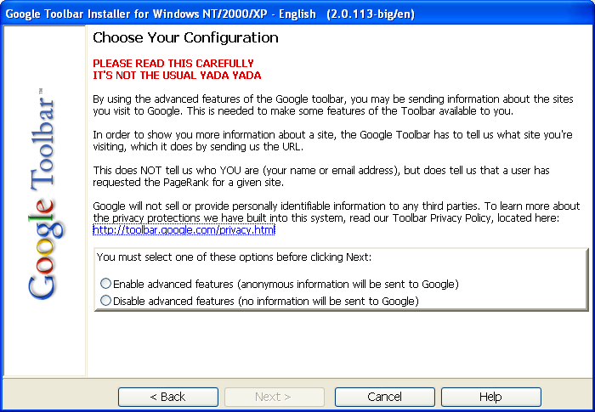
Google Toolbar (circa 2000)

