Slide 1
Copyright and AI:
The Building Blocks
Jody Blanke
Mercer University
July 23, 2026

Slide 2
Three Basic Questions
Does the copying of copyrighted works used for training generative AI models infringe upon the copyright of those works?
Does the output generated by an AI model infringe upon copyrighted works used for training?
Is the output generated by an AI model copyrightable?

Slide 3
Three Basic Themes
Technology often drives changes in the law. Nowhere has this been truer than with respect to copyright law.
The law is resilient and adapts to disruptive technology.
The more things change, the more they remain the same.

Slide 4
Five Basic Building Blocks
The Idea-Expression Dichotomy
Originality
Human Authorship
Substantial Similarity
Fair Use

Slide 5
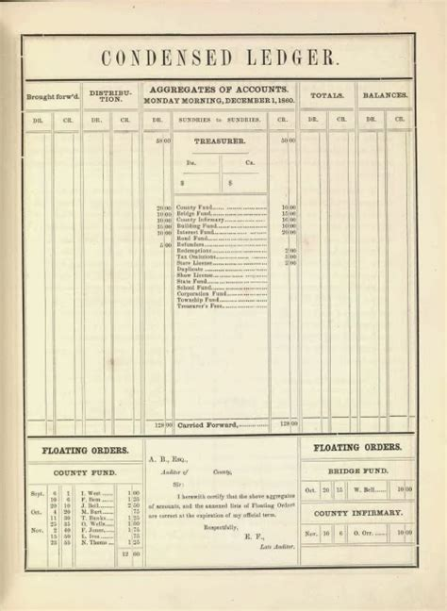
Idea-Expression Dichotomy: Baker v. Selden
Baker v. Selden (1879) established that copyright can protect only expression, not the idea itself (copyright does not protect a system of bookkeeping methods).
Every creative work is both idea and expression; separating the two is an act of judgment.
  “Nobody has ever been able to fix that boundary, and nobody ever can.”
  - Judge Learned Hand, Nichols v. Universal (1930).

Slide 6
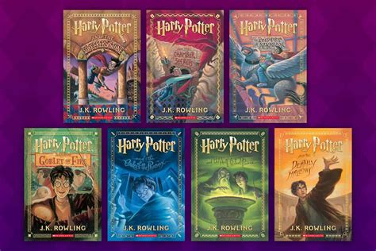
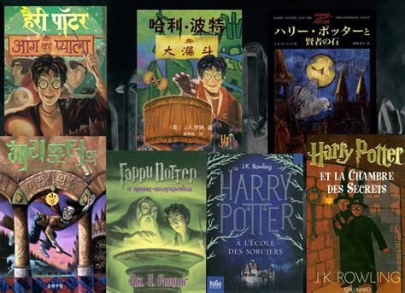
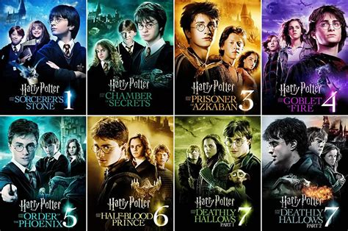
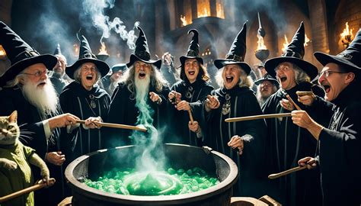
Idea-Expression Dichotomy:
Thin Protection and Derivative Works
J.K. Rowling can protect the expressive elements of Hogwarts and Harry and Ron and Hermione. She cannot prevent others from writing stories about witches and wizards in the UK.

Slide 7
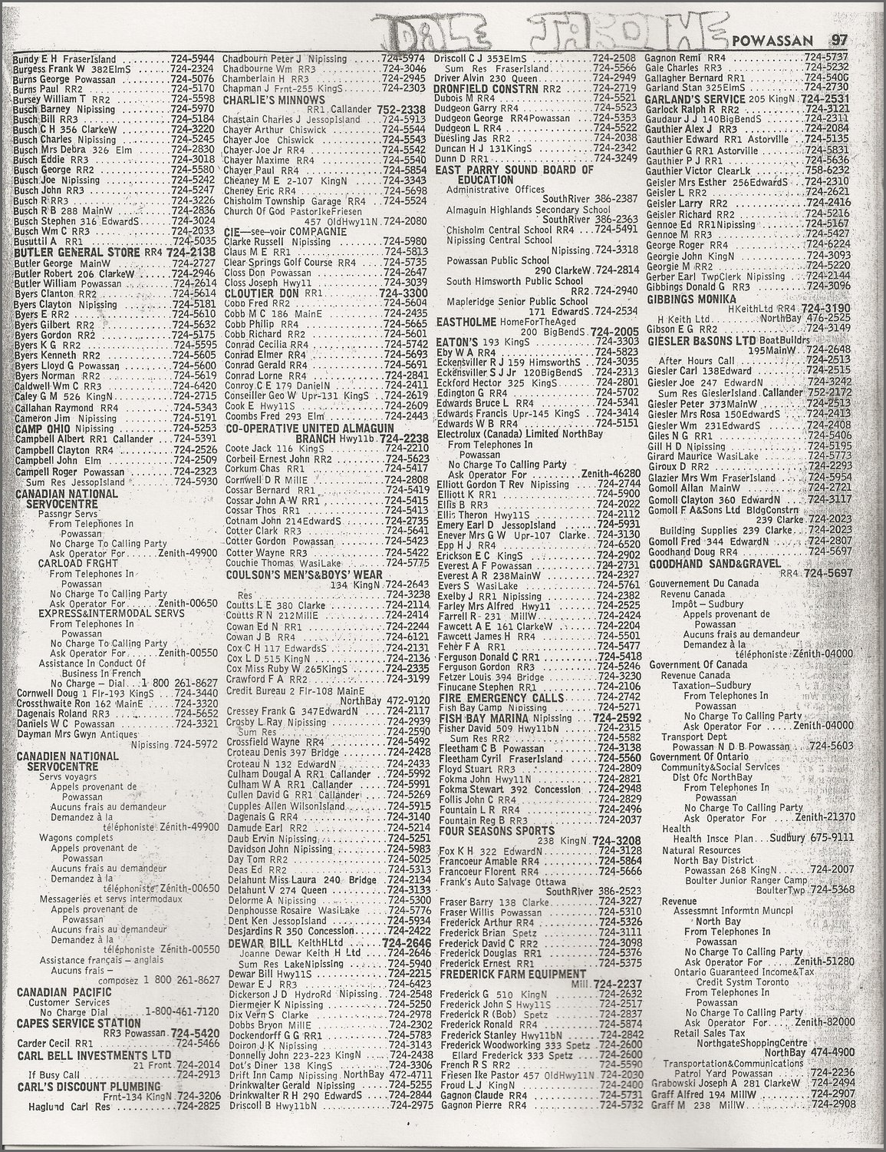
Originality: Feist v. Rural Telephone
The Feist case (1991) rejected the old “sweat of the brow” doctrine. It held that facts are not copyrightable; only the author’s original selection of arrangement of those facts qualifies for protection.
  “The primary objective of copyright is not to reward the labor of authors, but ‘[t]o promote the Progress of Science and useful Arts.’ To this end, copyright assures authors the right to their original expression, but encourages others to build freely upon the ideas and information conveyed by a work.”

Slide 8
Originality:
The Database Debate and the AI Analogy
In the aftermath of Feist, there was much discussion about creating a sui generis form of protection. It was rejected in the U.S.
The curation and use of data and data sets for training AI models may present an analogy in favor of the copying of massive amounts of data for training purposes.

Slide 9
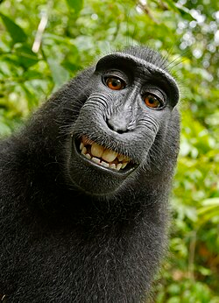
Human Authorship
Can a macaque get a copyright?
No. Naruto v. Slater (2018).
U.S. copyright law presupposes a natural person behind the work.

Slide 10
Human Authorship: AI
In Thaler v. Perlmutter (2023) the D.C. Circuit held that copyright protection extends only to human-created works and that a computer-generated image lacking human authorship is not registrable.
Later in 2023 the Copyright Office confirmed this by stating that copyright subsists only in the human-authored portions of a work. Applicants must disclose any AI-generated material and may claim protection only for their own creative contributions—such as the selection, coordination, or modification of AI outputs. They must disclaim any portion of the work that does not meet the human-authored standard.

Slide 11
Human Authorship: International Law
International law varies on this point:
  The United Kingdom, in a law enacted before the development of AI, recognizes protection for works “generated by a computer in circumstances such that there is no human author of the work.”
  China recognized copyright in a case where an author made extensive prompts and modifications to the output of an AI image-generator, to the extent that the image produced was the result of the author’s “intellectual achievements.”
  The European Union states that AI-generated content may be eligible for copyright “only if the human input in [the] creative process was significant.”
There will be a lot of activity regarding how much prompting is enough prompting in order to qualify for human authorship.

Slide 12
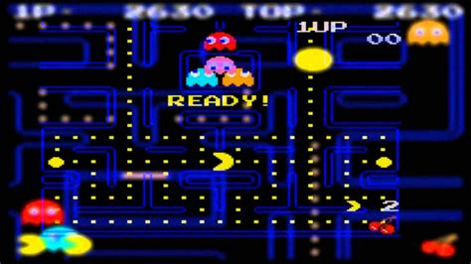
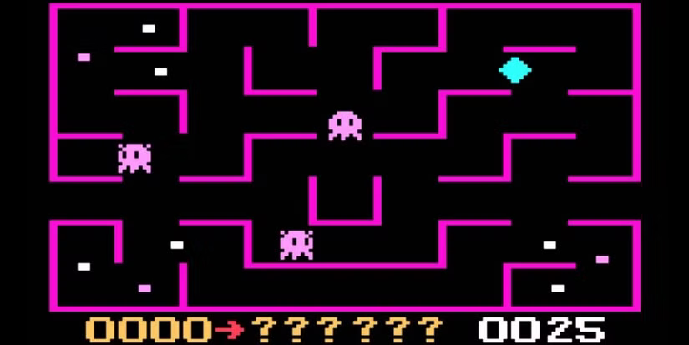
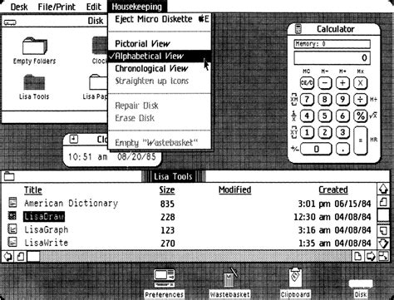
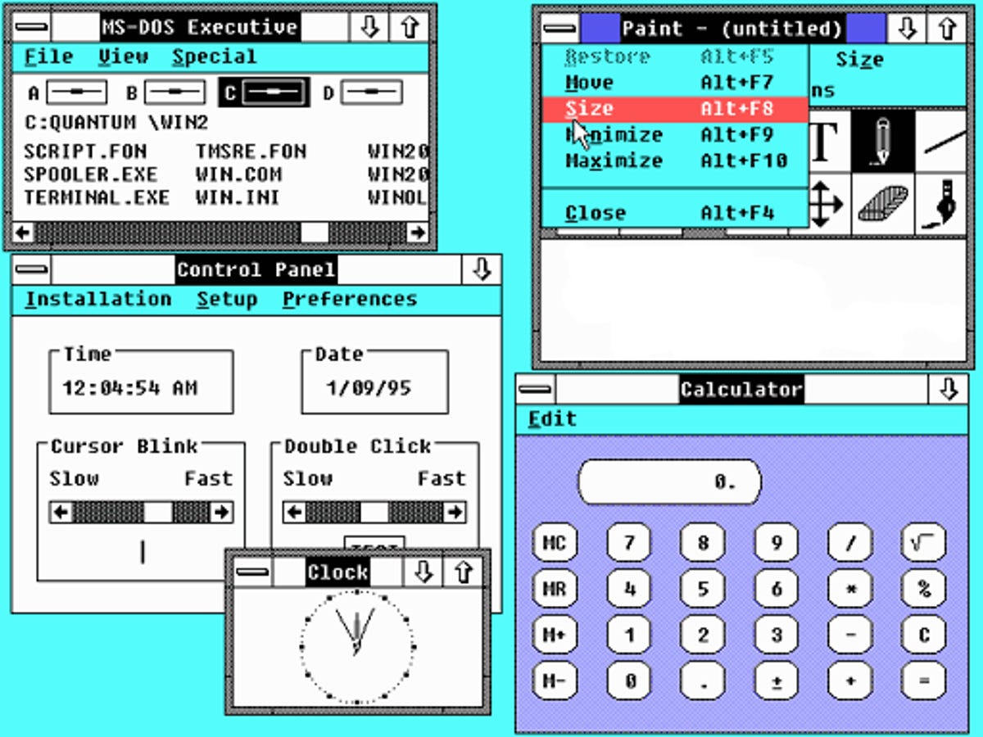
Substantial Similarity: “Look and Feel”
In the 1980s and 1990s there was much discussion about the “look and feel” of computer programs and interfaces.
  Pac Man vs. K.C. Munchkin (1982)
  Apple v. Microsoft (1994)

Slide 13
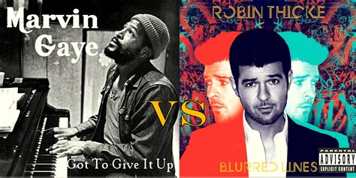
Substantial Similarity: Marvin Gaye’s “Vibe”:
Williams v. Gaye (2018)
The Ninth Circuit handed down an awful decision based upon its subjective “intrinsic” test: “whether the ordinary, reasonable person would find the total concept and feel of the works substantially similar.”
The dissent correctly summarized the situation:
  “The majority allows the Gayes to accomplish what no one has before: copyright a musical style. ‘Blurred Lines’ and ‘Got to Give It Up’ are not objectively similar. They differ in melody, harmony, and rhythm. Yet by refusing to compare the two works, the majority establishes a dangerous precedent that strikes a devastating blow to future musicians and composers everywhere.”

Slide 14
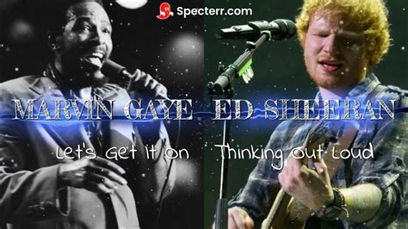
Substantial Similarity: Marvin Gaye’s “Vibe”:
SAS v. Sheeran (2024)
The Second Circuit affirmed a jury verdict for Ed Sheeran, stating that under Feist, “a work consisting of unprotectable elements may still be protectable as an original ‘selection and arrangement’ of those elements.”
It held, however, that this claim failed because “it risks granting a monopoly over a combination of two fundamental musical building blocks. The four-chord progression at issue—ubiquitous in pop music—even coupled with a syncopated harmonic rhythm, is too well-explored to meet the originality threshold that copyright law demands.” [The Supreme Court denied cert. in 2025]

Slide 15
Fair Use: Four Factors [17 U.S.C. § 107]
(1) the purpose and character of the use, including whether such use is of a commercial nature or is for nonprofit educational purposes;
(2) the nature of the copyrighted work;
(3) the amount and substantiality of the portion used in relation to the copyrighted work as a whole; and
(4) the effect of the use upon the potential market for or value of the copyrighted work.

Slide 16
Fair Use: Campbell v. Acuff Rose Music (1994)
In Campbell, the Supreme Court re-oriented the fair-use doctrine from mechanical factor-counting toward a contextual inquiry focused on meaning and purpose. The Court held that 2 Live Crew’s raunchy version of Roy Orbison’s classic “Oh, Pretty Woman” was a fair use because it commented on the original and added a new expression or message. This shift emphasized that the question is not how much was taken, but rather to what end it is taken and used: has it transformed into something else?

Slide 17
Fair Use: Warhol v. Goldstein (2023)
In Warhol, the Supreme Court re-emphasized factor four:
The Court stressed that transformation must be evaluated for the specific secondary use at issue, not in the abstract, and held that licensing a Warhol silkscreen into the same editorial market as the underlying copyrighted photograph is not transformative (even if it is a ‘Warhol.’) In that sense, Warhol narrows Campbell’s reach: aesthetic difference alone won’t satisfy factor one where the secondary use targets the same market as the original. Put differently, Campbell’s “adds something new” inquiry no longer carries the day unless the purpose and market context of the second use are distinct.

Slide 18
Fair Use:
Transformation, Market Effect, and AI
Prior to Warhol, the Second Circuit had found that Google’s wholesale digitization of books for search indexing was “highly transformative” because it enabled new alaysis without substituting for the originals. (Author’s Guild v. Google, 2015).
Warhol strengthens the argument for training as fair use, although likely weakens the argument for outputs that are (substantially) similar, particularly for images.

Slide 19
The Right of Publicity:
Where Likeness Meets Expression
The boundary between copyright and the right of publicity marks one of the most complex intersections in modern intellectual property law. Both doctrines seek to encourage creativity and prevent misappropriation, yet they protect fundamentally different subjects. Copyright governs expression, the creative form of an idea once fixed in a tangible medium, while the right of publicity safeguards identity, the commercial value of an individual’s name, likeness, or persona. Where copyright limits the copying of expression, the right of publicity limits the copying of self.
This distinction, however, has never been perfectly clean.

Slide 20
“Band Hero on Steroids:” The Hypothetical
“A video game company creates a music simulation game that contains the top one hundred bands of all time, along with each band’s fifty most popular songs. Avatars for each band look exactly like the real-life members. Each of the hundred bands can perform every song included in the game in a style unique to that band. Furthermore, there is a ‘genius’ mode that permits a user to enter anywhere from five to one hundred words and/or musical notes and the game will generate a song from those words and/or notes in the style and sound of any specified band. The performances can be saved and transferred to other forms of media.”
    Jordan M. Blanke, No Doubt About It - You’ve Got to Have Hart: Simulation Video Games May Redefine the Balance Between and Among The Right of Publicity, The First Amendment, and Copyright Law,19 Boston University Journal of Science & Technology Law 26 (2013).

Slide 21
“Band Hero on Steroids:” The Questions
“What happens when technology permits a user to use avatars to not only visually perform the song of another artist, but to use the distinctive voice or sound or style of that group to perform the other artist’s work? . . . What if users could choose any of the one hundred bands included in … ‘Band Hero on Steroids’ to perform any of the 5,000 songs included in the game? What if a user could input a few (or many) words and/or melodies and request a performance in the voice or style of The Beatles or The Beach Boys or Cage the Elephant? Technology will likely bring this to a gaming console or computer in the near future. . . What will be—and who will own—the copyright interests (if any) in the works and performances created by the game? “

Slide 22
The Right of Publicity and AI
The right of publicity is state law and there is substantial variation among state laws.
Cases involving the right of publicity and AI will continue long after copyright and AI questions are (largely) resolved.

Slide 23
Current AI-Copyright Litigation:
The Common Issues
Fair Use and the Transformative Inquiry
  Does training involve a transformational purpose (i.e., informational rather than expressive) sufficient to warrant fair use protection?
Output and Originality
  Does output from an AI model embody sufficient human creativity to merit copyright protection?
Ingestion and the Idea-Expression Dichotomy
  Is ingestion of copyrighted works for training merely the functional use of ideas, styles, and facts, or does it copy expression?
  There will be much legal activity regarding prompting.

Slide 24
Current AI-Copyright Litigation:
The Common Issues
Style, Substantial Similarity, Derivative Works, and Rights of Publicity
  As AI models become capable of reproducing the near-perfect “essence” of an artist’s style, does this involve the copying of expression or is it merely exploring an idea?
  This doctrinal line will probably be adjusted as it was for software, software interfaces, and music.
Memorization, Safeguards, and Unlearning
  As AI models become more sophisticated, they will be better able to avoid rote copying of expression.

Slide 25
Current AI-Copyright Litigation:
The Common Issues
The Digital Millenium Copyright Act
  The trend among courts so far has been to reject Section 1201 claims regarding circumvention of anti-circumvention tools and Section 1202 claims regarding removal or alteration of CMI.
Sourcing and Licensing
  A new market for the sourcing and licensing of training materials will likely develop, particularly after the Bartz v. Anthropic decision where the defendant AI company ended up paying $1.5B for using piarated copies of copyrighted works.

Slide 26
Major Generative AI Cases
Bartz v. Anthropic (N.D. Cal 2025)
  In one of the most significant generative AI cases to be decided, this was a major victory for AI companies, but with a significant proviso. The court issued a resounding summary judgment on fair use in favor of the defendant. In order to train its AI software tool, Claude, Anthropic spent millions of dollars to acquire millions of books. It cut the pages of the books into scannable images and discarded the books. Training sets were carefully curated, pages were cleaned, tokens were generated and processed. In the end, there was nothing traceable to the authors’ works. The court granted summary judgment to Anthropic holding that its use of the books to train Claude “was exceedingly transformative and was a fair use.”

Slide 27
Major Generative AI Cases
Ramifications of Bartz
  it is a strong decision that training on copyrighted works is likely a fair use;
  it is a strong indictment against the use of pirated works;
  it may set a floor for such copyright violations ($3,000 per work);
  it illustrates the existential risk for all but the largest companies; and
  it marks a strong push towards the creation of a licensing market for works used in AI training.

Slide 28
Major Pending Generative AI Cases
Getty Images v. Stability AI (N.D. Cal)
  Copyright claims involving the direct copying of 12 million images used to train defendant’s Stable Diffusion AI model. Getty alleges that its proprietary watermark and other distinctive features appear in AI outputs, demonstrating literal reproduction. It also asserts a trademark claim. Stability’s main defense hinges on fair use. It contends that its use of the images as training data is a transformative use, that is, extracting non-copyrightable information, like styles and patterns, to create new outputs. It analogizes this use to those involving search engine indexing or public domain archiving. Getty argues that Stability’s use is not transformative because the resulting image generator is a market substitute and directly competes with its licensing business.
  Copyright and trademark claims are still being litigated.

Slide 29
Major Pending Generative AI Cases
New York Times v. Microsoft, OpenAI et al (S.D.N.Y)
  Consolidation of several lawsuits
  Multidistrict litigation to proceed in SDNY
  Involves copyright claims pertaining to training and output, trademark dilution claims, and a DMCA claim under Section 1202(b)(1).
  The decision will likely set the direction for modifications to copyright (and trademark) law. Whatever the decision, it will likely be appealed.
  Major case to watch.

Slide 30
The Newest Building Block
As has always been the case, and as will inevitably always be the case, social values and technology will continue to evolve, and as they evolve, so will the law. Copyright has often been on the cutting edge of technological adaptation. AI may very well be the most significant driver of change that we have ever seen, and it will continue to be so for quite some time. Modifications to copyright law may be one of the easier transitions the law will have to make.

Slide 31
The Newest Building Block
I think we will see significant changes in the way data is collected, sourced, cleaned and collated. We will see changes in the way that models are trained. Issues in law are often assisted or solved by changes in technology. Some of these technological changes will solve today’s problems and some will cause tomorrow’s problems.

Slide 32
The Newest Building Block
Training of AI models will become an accepted fair use. It has to be. AI is too powerful an innovation to stop now. It is a societal game-changer and the law will find a way to intelligently and gracefully make the needed accommodations. The Constitutional edict to promote the progress of science and the useful arts is too strong.

Slide 33
The Newest Building Block
A new copyright building block will evolve. It will permit the training of AI models with copyrighted works. Rules will develop for accessing or sourcing materials; a licensing scheme is likely. The idea-expression dichotomy will remain firm. The notion of originality will remain, but human authorship will necessarily become more accepting of machine contributions to human creativity. As AI becomes accepted as merely another tool, humans will use it in creative ways and be able to claim authorship for those creative uses.

Slide 34
The Newest Building Block
Substantial similarity will remain a solid building block, but new balancing tests will emerge as the sophistication of the technology increases. Image and music generation will be driving many of these changes with regard to substantial similarity. Right of publicity laws will have to change. A state-by-state approach with IP-like protection will not be able to co-exist with federal standards for copyright. First Amendment principles will shape some of those changes.

Slide 35
Conclusion
Copyright law is resilient. It has evolved greatly over the last 250 years. It will continue to evolve. Its building blocks will remain fairly constant. Inevitably, the advancement of technology will require that modifications be made to existing law. But by and large, there will not be many brand-new, principle-altering changes. The changes will likely fit easily and logically into copyright’s existing frameworks. The sky is not falling. Yes, the world is changing, but there will still be a sky.

Slide 36
Conclusion
The basic building blocks of copyright have existed for a long time and have evolved when necessary. New building blocks develop when needed. Another theme of this article is that the more things change, the more they remain the same. We are now at one of the biggest junctures in the history of law and technology. Yes, there are a lot of changes occurring, but the basic legal principles are flexible enough to adapt. We live in exciting times. We are lucky to watch the law adapt and evolve.

