Slide 1
Introduction to Smart Cities
Jody Blanke
Distinguished Professor of Computer Science and Law

Slide 2
Reference
Smart Cities, Big Data, and the Resilience of Privacy
by Janine S. Hiller and Jordan M. Blanke
Hastings Law Journal, Volume 68, Issue 2, 309-56 (2017)

Slide 3
Smart City

Slide 4
Sensors and IoT

Slide 5
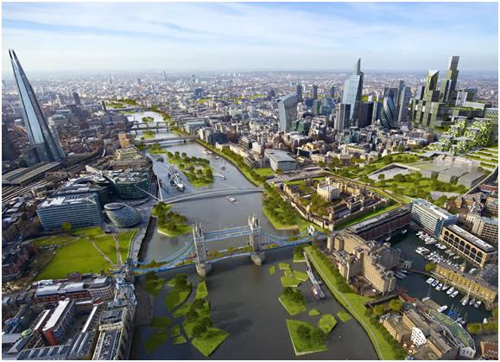
The Future – Idyllic?

Slide 6
The Future – Dystopian?

Slide 7
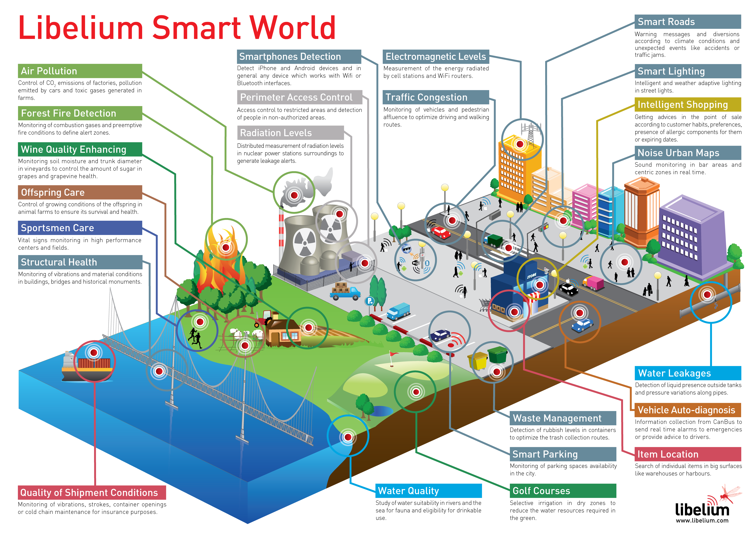
Smart Cities

Slide 8
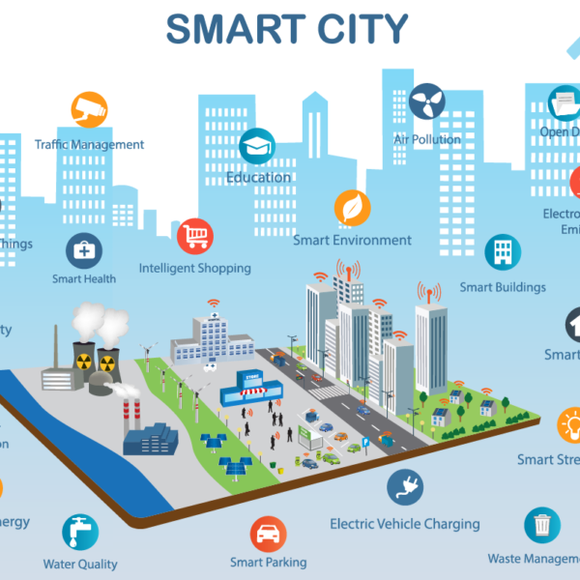

Slide 9
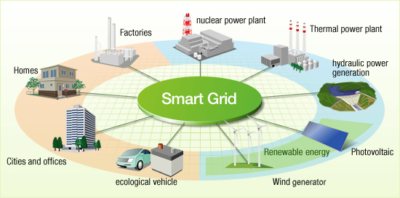
The Smart Grid

Slide 10
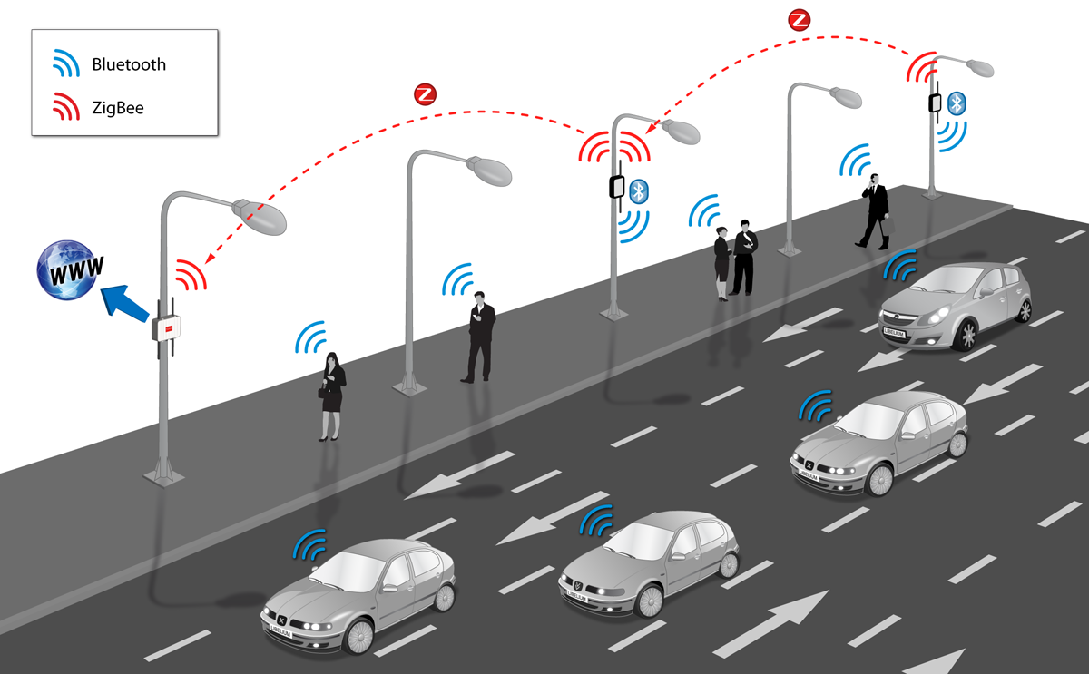
Traffic

Slide 11
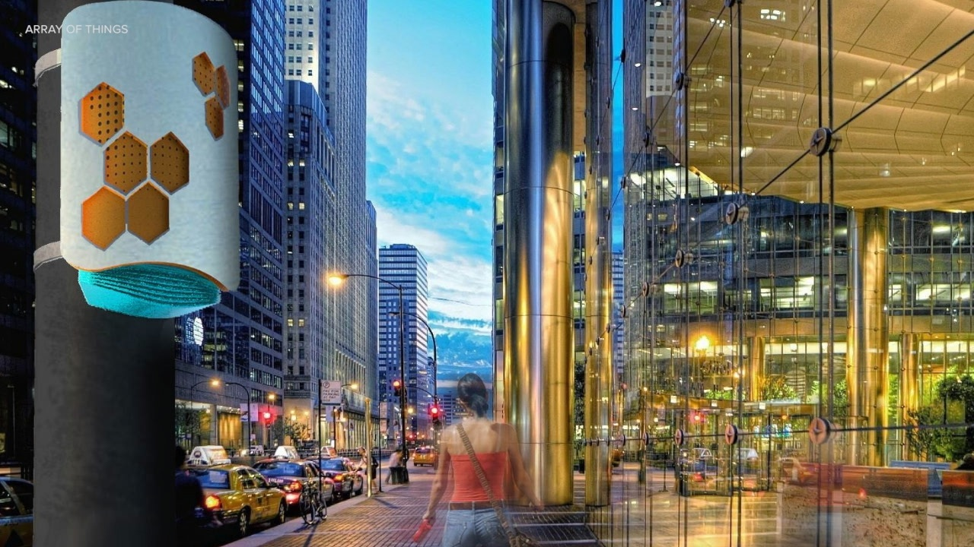
Chicago’s Array of Things

Slide 12
Chicago’s Array of Things

Slide 13
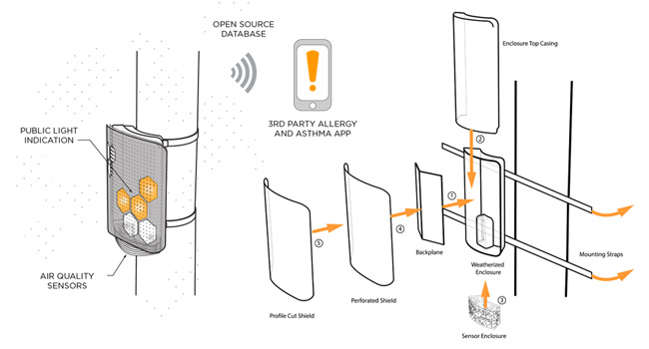
Chicago’s Array of Things

Slide 14
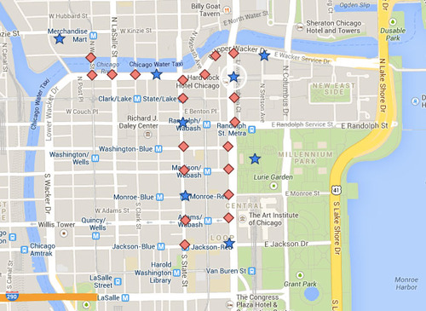
Chicago’s Array of Things

Slide 15
Chicago’s Array of Things
What is the Goal of the Array of Things?
AoT will provide real-time, location-based data about urban environment, infrastructure and activity to researchers and the public. This initiative has the potential to allow researchers, policymakers, developers and residents to work together and take specific actions that will make cities healthier, more efficient and more livable. The data will help cities operate more efficiently and realize cost savings by anticipating and proactively addressing challenges such as urban flooding and traffic safety.
Because the data will be published openly and without charge, it will also support the development of innovative applications, such as a mobile application that allows a resident to track their exposure to certain air contaminants, or to navigate through the city based on avoiding urban heat islands, poor air quality, or excessive noise and congestion.
Future Cities: Palo Alto, Seattle, Portland, Denver, Chapel Hill, and Syracuse.
https://arrayofthings.github.io/

Slide 16
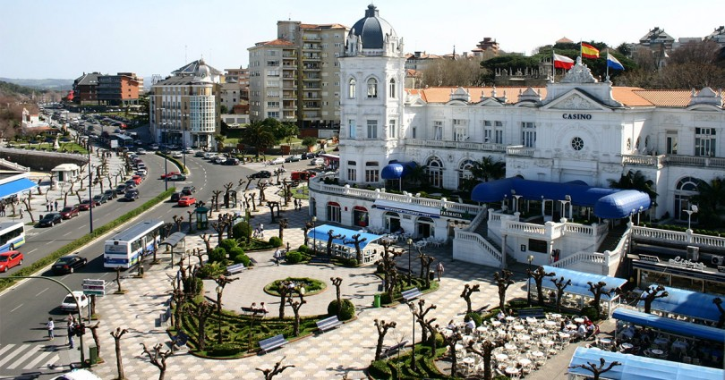
Santander, Spain

Slide 17
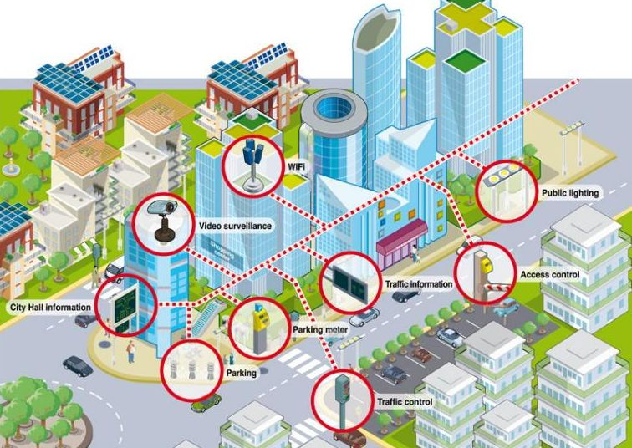
Santander, Spain

Slide 18
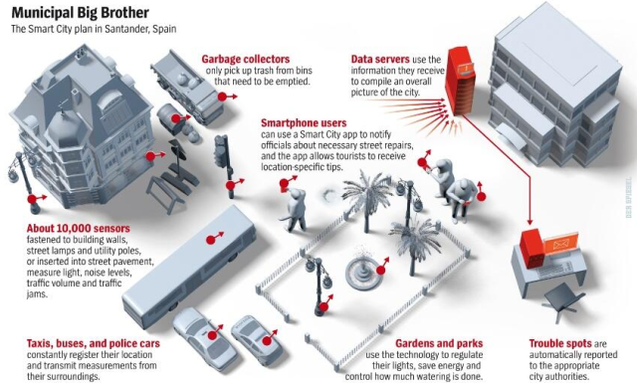
Santander, Spain

Slide 19
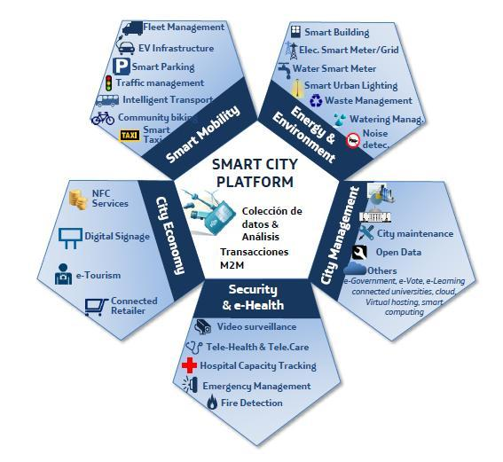
Santander, Spain

Slide 20
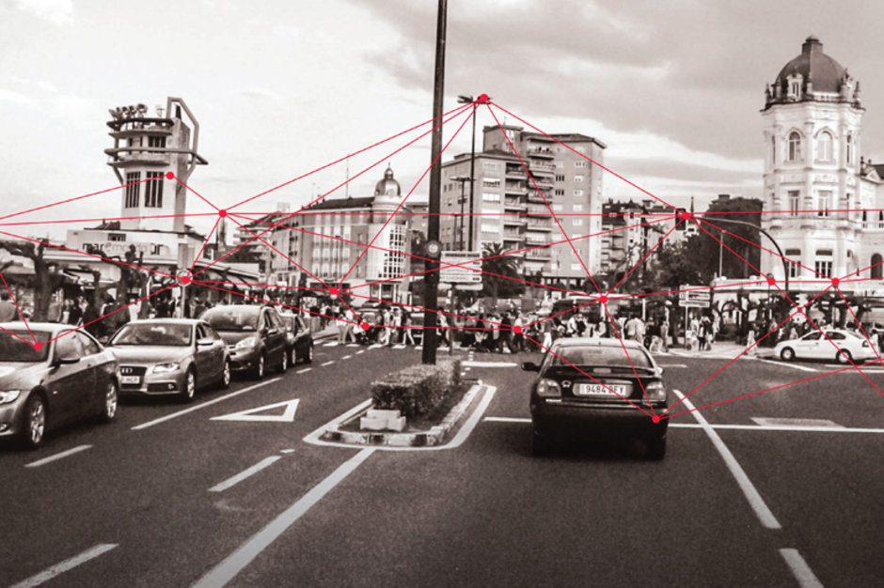
Santander, Spain

Slide 21
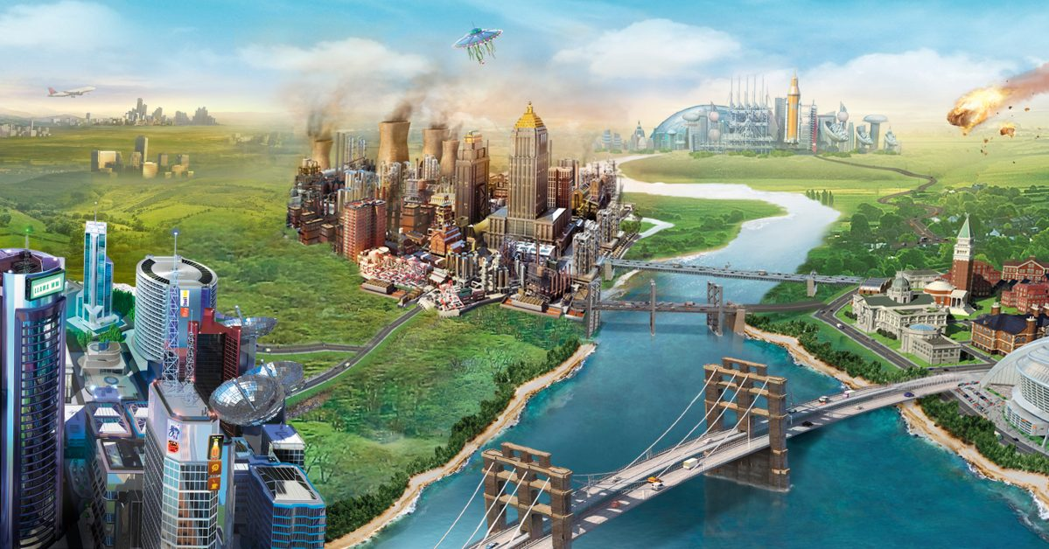
Sim City

Slide 22
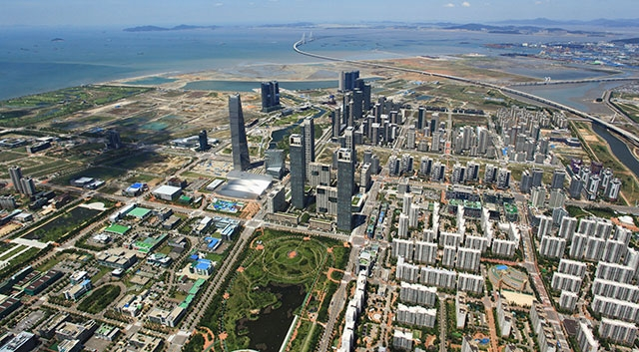
Songdo, South Korea

Slide 23
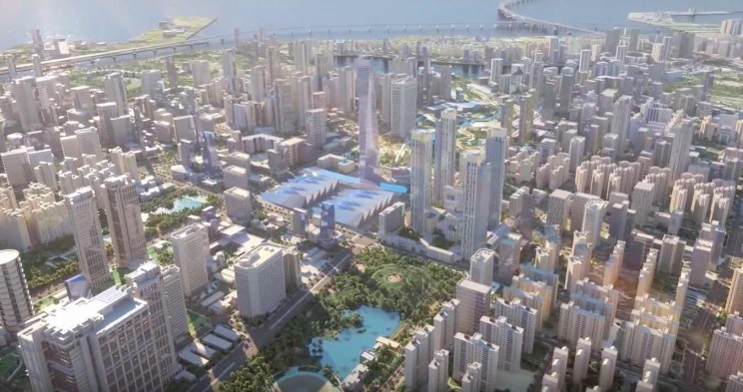
Songdo, South Korea

Slide 24
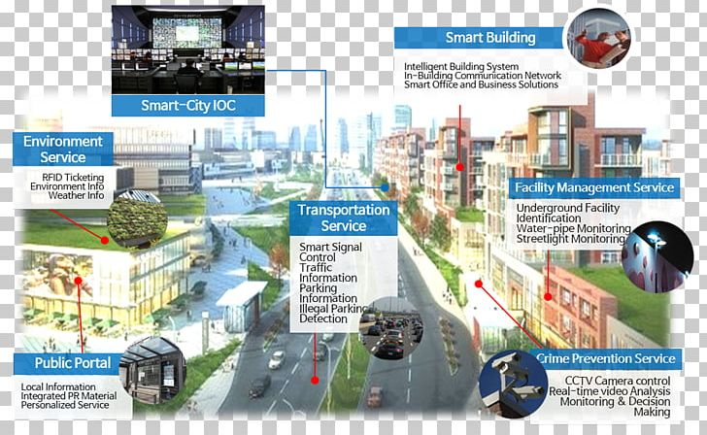
Songdo, South Korea

