Slide 1
Big Data, Smart Cities, and Privacy Resilience

Slide 2
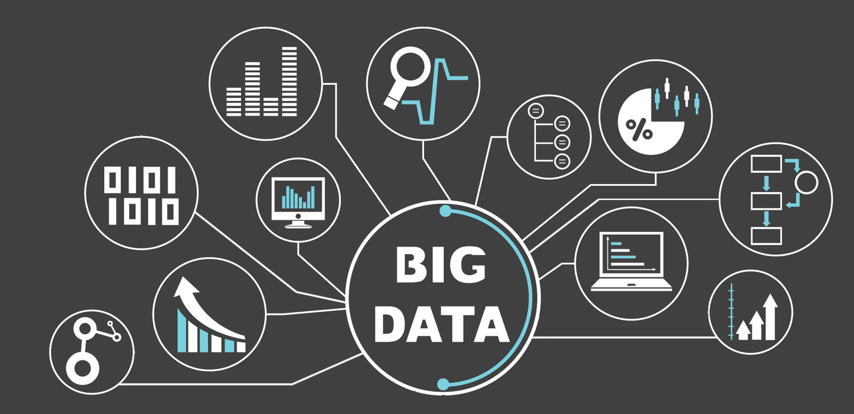
Big Data is Everywhere

Slide 3
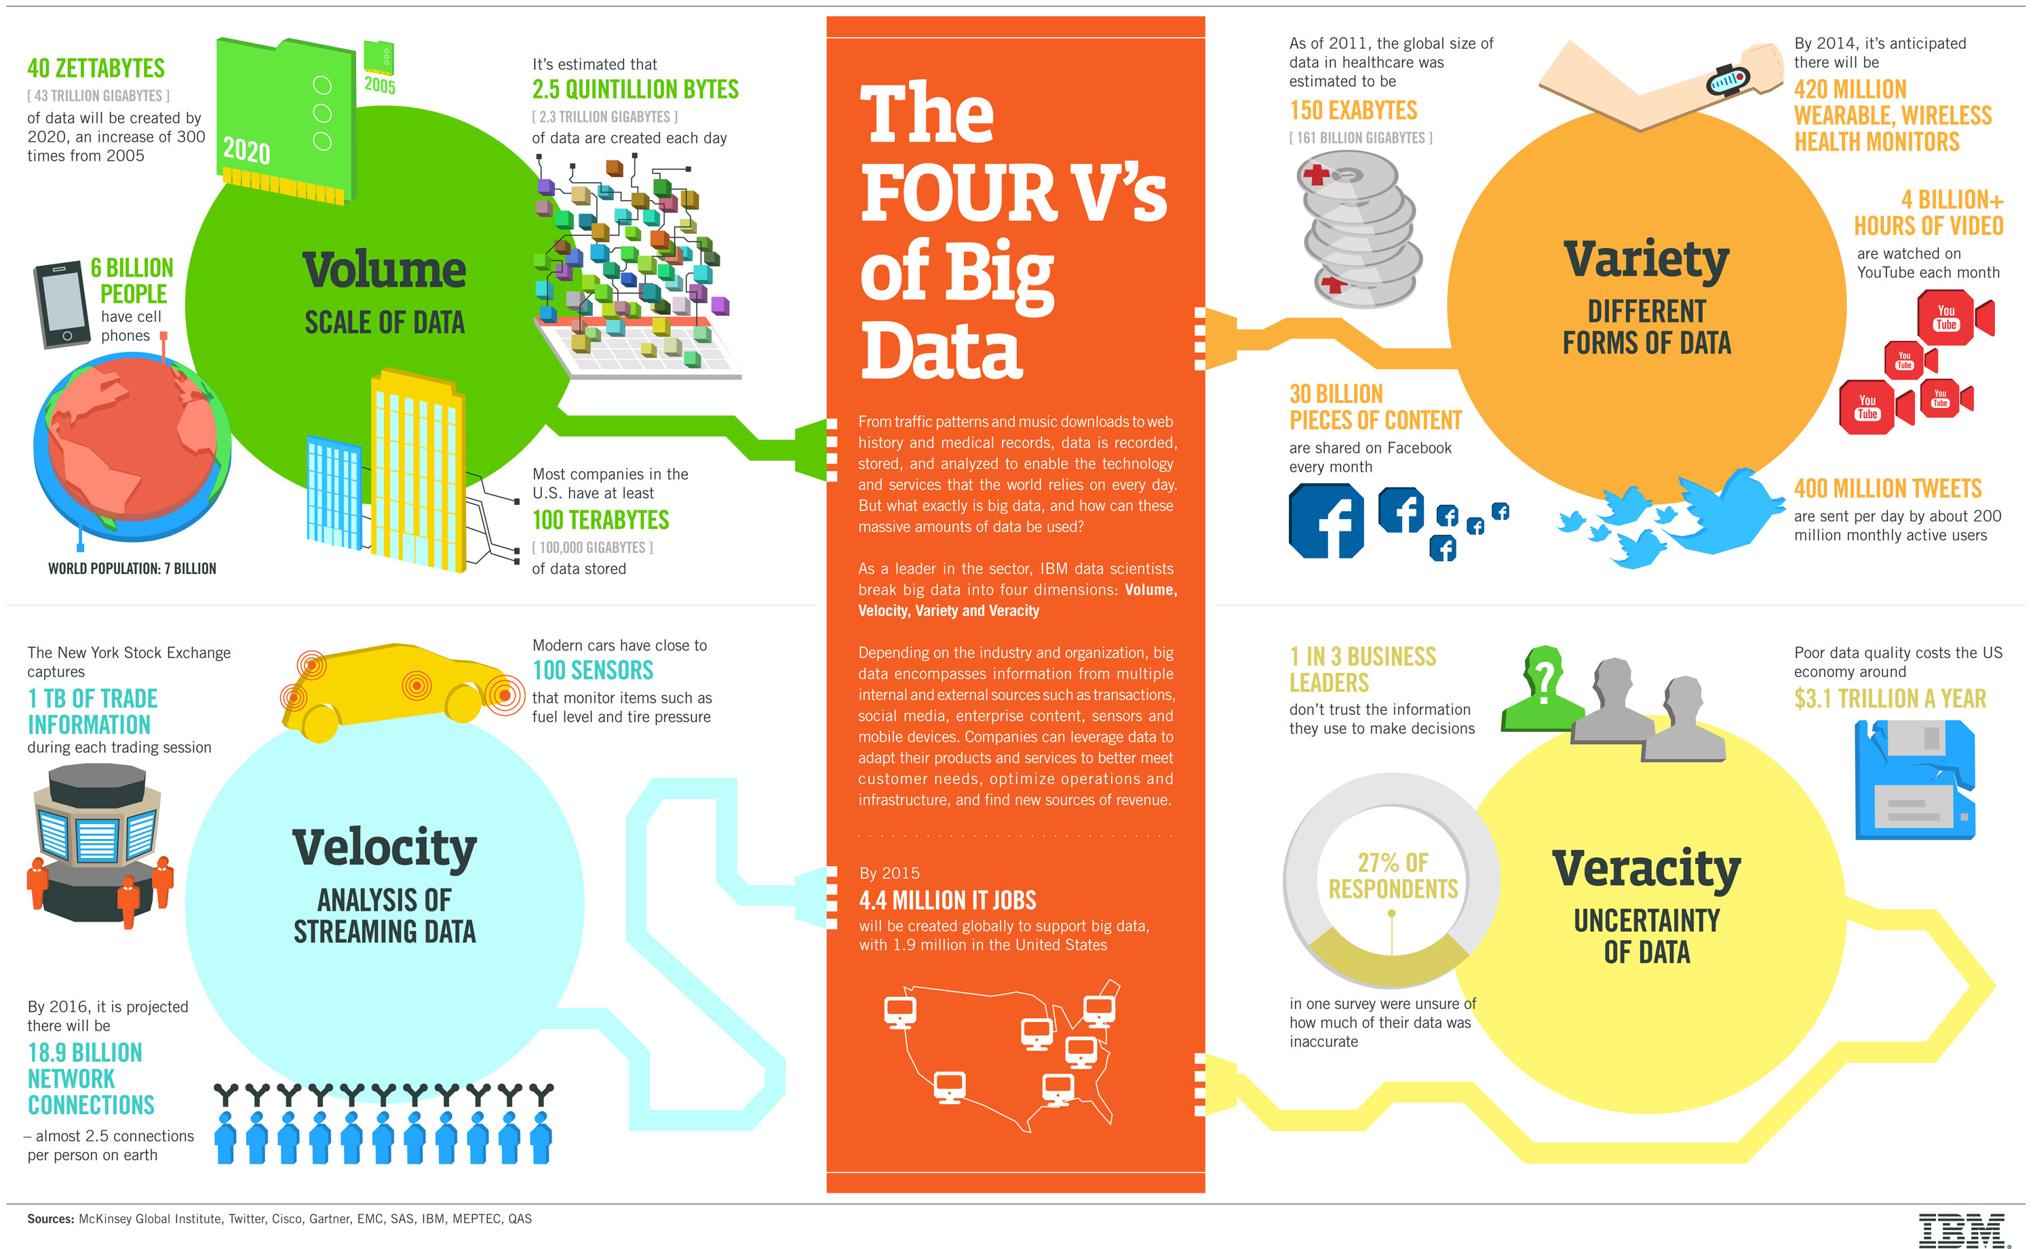
Big Data

Slide 4
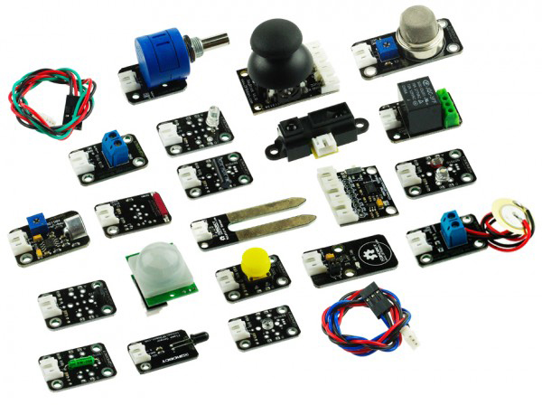
Sensors

Slide 5
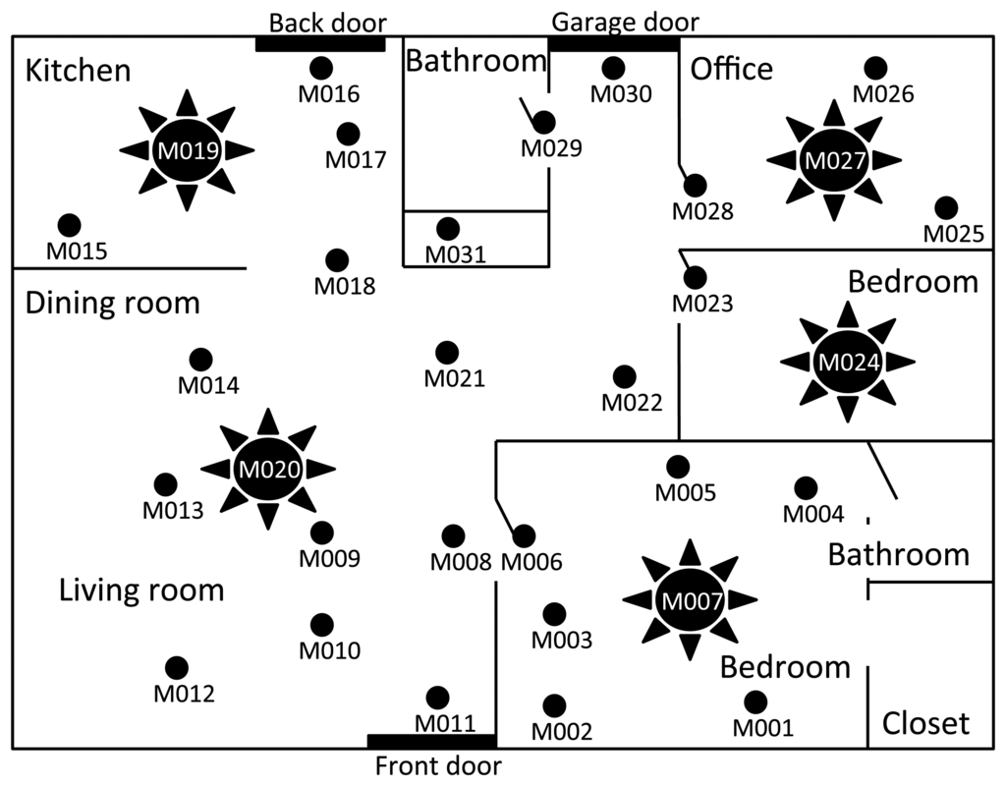
Sensors in the Home

Slide 6
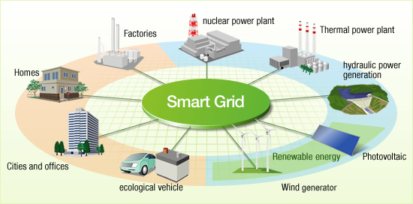
The Smart Grid

Slide 7
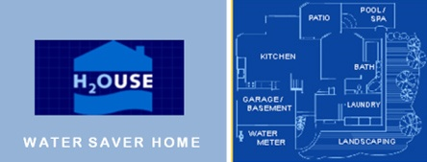
Water

Slide 8
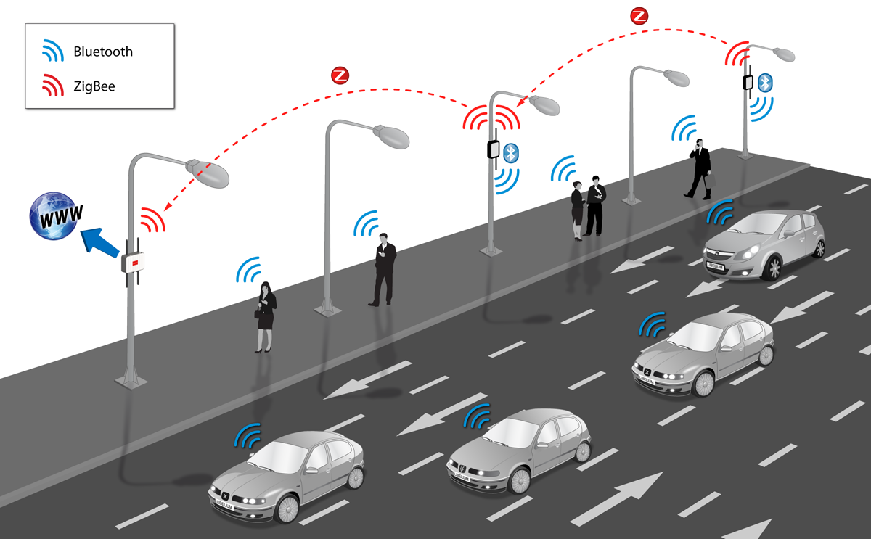
Traffic

Slide 9
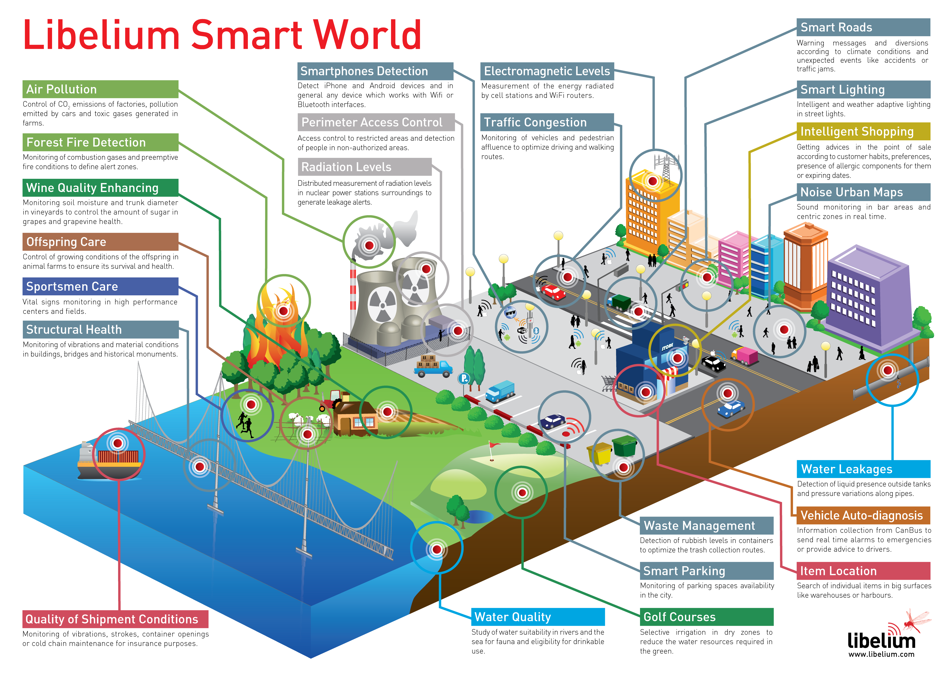
Smart Cities

Slide 10
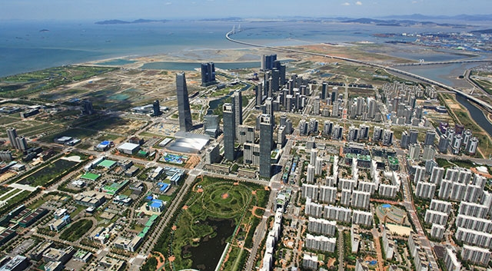
Songdo, South Korea

Slide 11
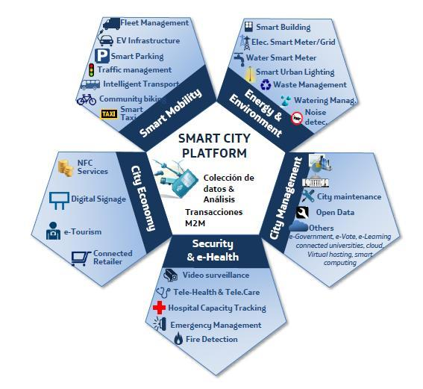
Santander, Spain

Slide 12
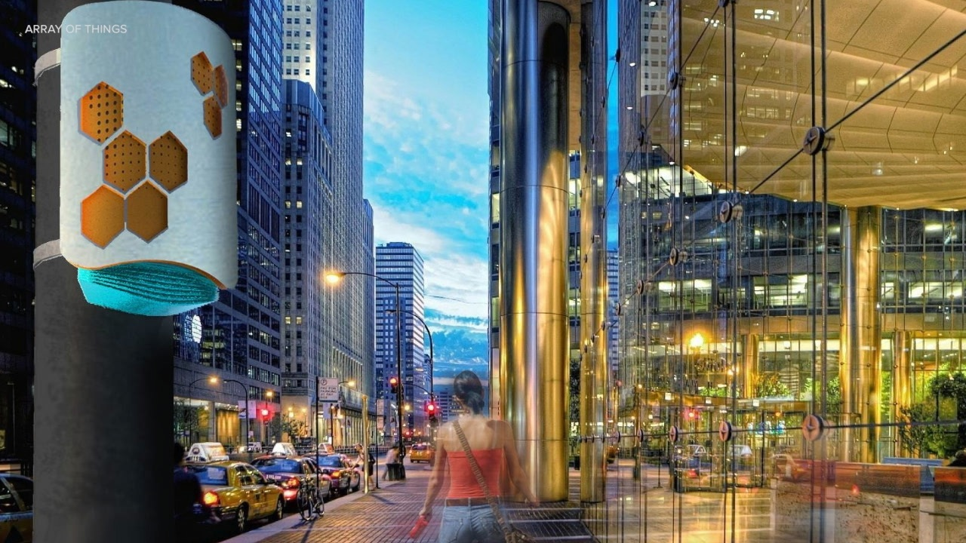
Chicago’s Array of Things

Slide 13
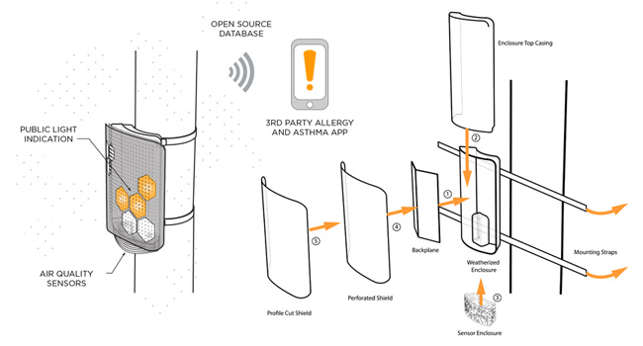
Chicago’s Array of Things

Slide 14
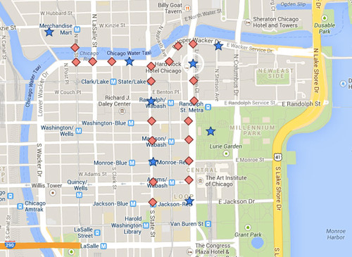
Chicago’s Array of Things

Slide 15
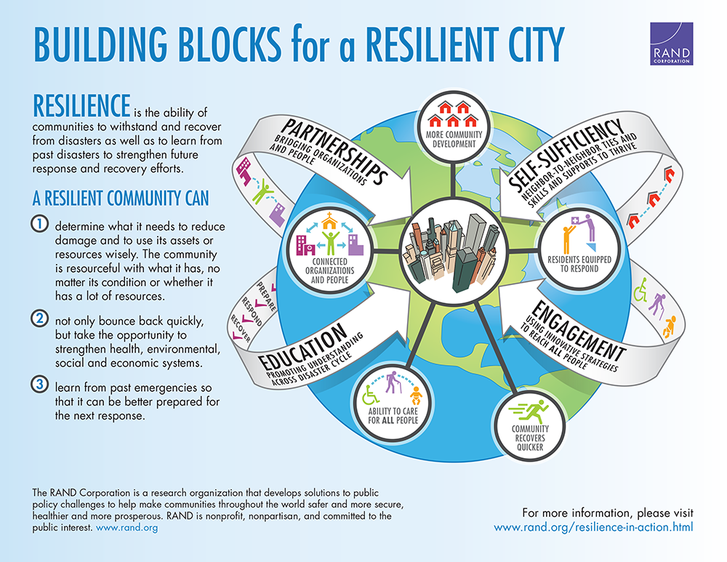
Resilient Cities

Slide 16
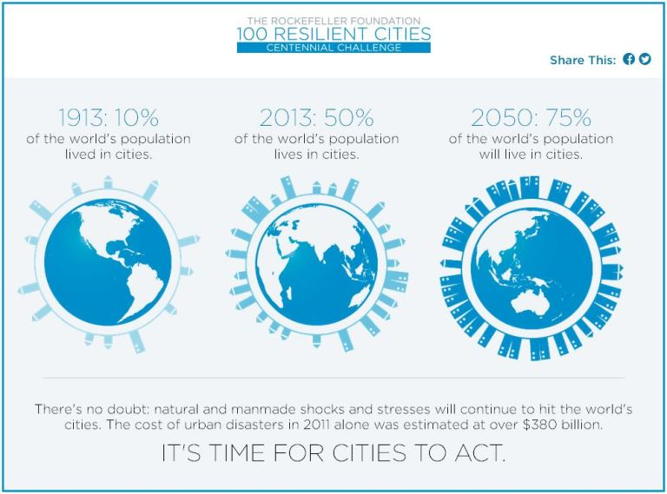
100 Resilient Cities

Slide 17
Resilient Cities

Slide 18
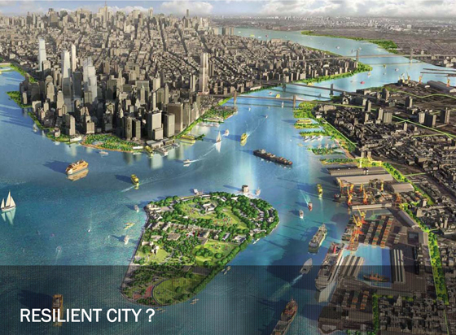
The Future?

Slide 19
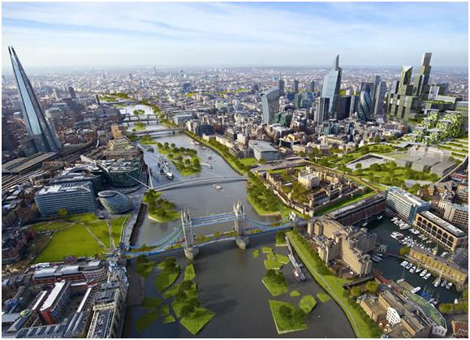
The Future?

Slide 20
The Future?

Slide 21
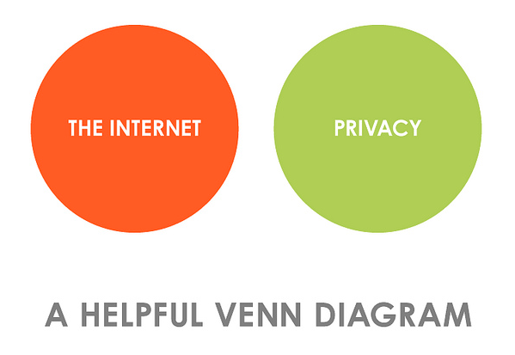
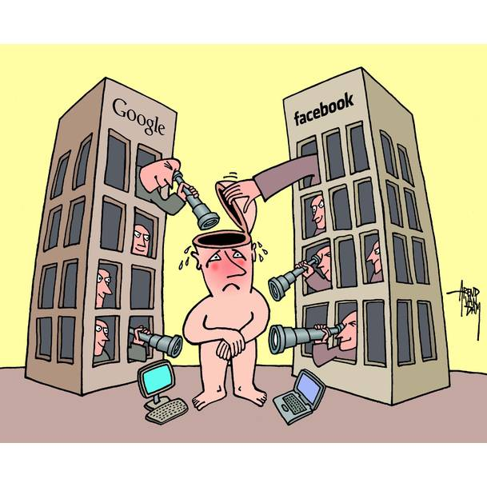
Is Privacy Possible?

Slide 22
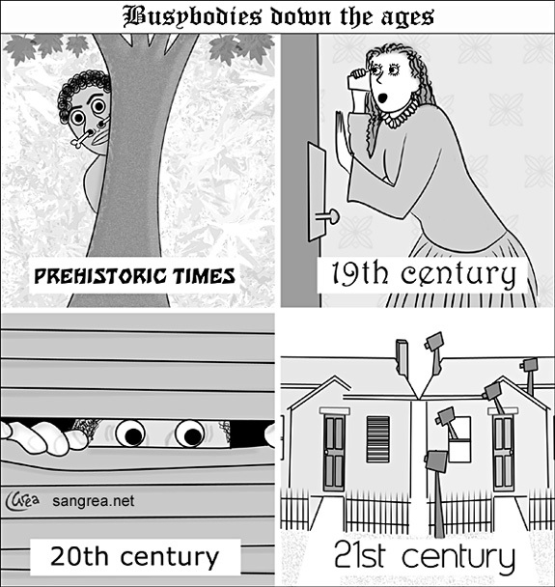
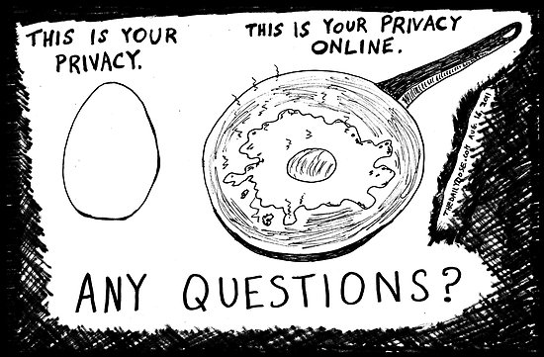
Privacy?

Slide 23
Resilience

Slide 24
Engineering Resilience

Slide 25
Ecological Resilience

Slide 26
Socio Ecological Resilience

Slide 27
Socio Ecological Resilience

Slide 28
Can Privacy be Resilient in a Smart City?
NIST FRAMEWORK FOR PRIVACY
COMPARE WITH OTHER TYPES OF RESILIENCY

Slide 29
ENGINEERING
PRIVACY?

Slide 30
Privacy Engineering Framework
A risk management solution
Frame Business Objectives
Frame Organizational Privacy Governance
Assess system Design
Assess Privacy Risk
Design Privacy Controls
Monitor Change

Slide 33
Plus: Two Unique Elements
Privacy Engineering objectives
Privacy Risk Model

Slide 34
OBJECTIVES: Communication
Predictability
Manageability
Disassociability

Slide 35
Privacy Risk Model
Liklihood of a problematic data action
×
Impact of a Problematic Action
=
Privacy Risk

Slide 36
Concluding thoughts
Is Privacy Engineering enough?
Does privacy need to evolve in order to be resilient in an era of the smart city, the Internet of Things and big data? (ecological resilience)
What would the evolution of privacy look like?
How does socio ecological resilience fit?

